Slide 1

VA CEDAR IDIQ TO1 VFS-DHM Reporting
Last updated: 1/3/2022
Contract #: 36C10B21D0007
Order #: 36C10B21N00070001

Slide 2
Mission
VA CEDAR IDIQ
The CEDAR IDIQ will connect VA employees with industry partners to deliver high-quality, digital products following modern best practices to improve service delivery to Veterans.

Slide 3
Objectives
VA CEDAR IDIQ
Give VA streamlined access to a small group of exceptional companies that specialize in agile software development and user-centered design
Create a contract mechanism that incentives VA employees and contractors to deliver rapidly following private sector best practices
Promote the principles of Agile and DevOps culture in VA
Support VA’s Digital Modernization Strategy to solve tough technology challenges facing VA

Slide 4
Product Vision
VA HEALTH APARTMENT (VETERAN FACING SERVICES-DIGITAL HEALTH MODERNIZATION)
To simplify and unify the Veteran digital health experience by creating an accessible, usable, and discoverable health “apartment” on VA.gov.
This will give Veterans a single place to accomplish all of their key health tasks.

Slide 5
VA CEDAR IDIQ TO1
VETERAN-FACING SERVICES – DIGITAL HEALTH MODERNIZATION
Compliance, Governance and Reporting Requirements
CLIN 0001AA: Delivery Report
CLIN 0001AB: Monitoring Report
CLIN 0001AC: Contractor’s Progress, Status and Management Report
CLIN 0001AD: Status of Government Furnished Equipment Report
CLIN 0001AE: Personnel Contractor Manpower Report
CLIN 0001AF: Contractor Staff Roster

Slide 6
Reporting Requirements
CLIN 0001AA
CLIN 0001AA: Delivery Report
CLIN 0001AB: Monitoring Report
CLIN 0001AC: Contractor’s Progress, Status and Management Report
CLIN 0001AD: Status of Government Furnished Equipment Report
CLIN 0001AE: Personnel Contractor Manpower Report
CLIN 0001AF: Contractor Staff Roster

Slide 7
VA CEDAR IDIQ TO1
VETERAN-FACING SERVICES – DIGITAL HEALTH MODERNIZATION
Compliance, Governance and Reporting
CLIN 0001AA: Delivery Report
CLIN 0001AB: Monitoring Report
CLIN 0001AC: Contractor’s Progress, Status and Management Report
CLIN 0001AD: Status of Government Furnished Equipment Report
CLIN 0001AE: Personnel Contractor Manpower Report
CLIN 0001AF: Contractor Staff Roster

Slide 8
Delivery Report
CLIN 0001AA
The Contractor shall provide a monthly report, detailing and providing links to all stories, epics, and other work completed. This includes all work accepted by the Product Owner and Contracting Officer Representative at the end of each sprint. This report shall include additional details about the project status, sprint team velocity, sprint team goal completion, and highlight project risks. The specific data points and format of this monthly report shall be determined by the Contractor in collaboration with the Government Product Owner and COR.
Links to all stories, epics, and other work completed
Additional details about the project status, sprint team velocity, sprint team goal completion, and highlight project risks

Slide 9
Reporting Roadmap
CLIN 0001AA
Contract Reporting Roadmap

Slide 10
VA CEDAR IDIQ TO1
VETERAN-FACING SERVICES – DIGITAL HEALTH MODERNIZATION
Compliance, Governance and Reporting
CLIN 0001AA: Delivery Report
CLIN 0001AB: Monitoring Report
CLIN 0001AC: Contractor’s Progress, Status and Management Report
CLIN 0001AD: Status of Government Furnished Equipment Report
CLIN 0001AE: Personnel Contractor Manpower Report
CLIN 0001AF: Contractor Staff Roster

Slide 11
Monitoring Report
CLIN 0001AB
The Contractor shall provide a monthly report, highlighting and providing links to key infrastructure and application monitoring data. The report shall include details with links to documentation for any critical incidents or outage events that resulted in service outages or significant service degradations. The Contractor shall attach or provide links to postmortem documentation for all critical incidents or outage events. The specific data points and format of this monthly report shall be determined by the Contractor in collaboration with the Government Product Owner and COR.
Provide links to key infrastructure and application monitoring data.
Include details with links to documentation for any critical incidents or outage events that resulted in service outages or significant service degradations.
Provide links to postmortem documentation for all critical incidents or outage events.

Slide 12
Show me, don’t tell me
Contract #: 36C10B21D0007
Order #: 36C10B21N00070001

Slide 13
Sprint Operating Model
CLIN 0001AB
Sprint Approval
Sprint Execution
Sprint Wrap Up
Ceremony | Conduct Backlog Prioritization, Sprint Planning and Document Sprint Approval Form | Submit Sprint Approval Form for Approval via email | Conduct Daily Standups and Deliver on Sprint Goals, EPICs, Stories, and Tasks | Conduct Sprint Demo and Retrospective | Submit Sprint Deliverables and Acceptance Form for Acceptance via email | Send Written Acceptance of Sprint via email | Submit Invoice via Tungsten
Approver / Accepter |  | VA Product Owner Tracey Mulrooney | VA Product Owner Tracey Mulrooney |  | VA Product Owner Tracey Mulrooney then VA COR Mary and Vilay | VA COR (Mary O.) | --
Lead | MO | MO | MO | MO | MO | DHM | MO
Contributor | DHM / MO | -- | DHM | DHM | -- | -- | --

Slide 14
Sprint Tracker
CLIN 0001AB
Task Order | 36C10B21N0070001 / 0001
CLIN | 0001
Sprint # | 0 | 1 | 2 | 3 | 4 | 5 | 6 | 7
Sprint Approver Name | Lauren Alexanderson | Lauren Alexanderson or Meg Peters | Meg Peters | Meg Peters | Tracey Mulrooney | Tracey Mulrooney | Tracey Mulrooney | Tracey Mulrooney
PoP | Base Year | Base Year | Base Year | Base Year | Base Year | Base Year | Base Year | Base Year
Running Total | 1 of 26 | 2 of 26 | 3 of 26 | 4 of 26 | 5 of 26 | 6 of 26 | 7 of 26 | 8 of 26
Approval Date | 9/7/2021 | 9/21/2021 | 10/1/2021 | 10/19/2021 | 11/2/2021 | 11/19/2021 | 12/3/2021 | 12/16/21
Start Date | 9/8/2021 | 9/22/2021 | 10/6/2021 | 10/20/2021 | 11/3/2021 | 11/17/2021 | 12/1/2021 | 12/15/21
End / Demo Date | 9/21/2021 | 10/5/2021 | 10/19/2021 | 11/2/2021 | 11/16/2021 | 11/30/2021 | 12/14/2021 | 12/28/21
PO Acceptance Date | 9/21/2021 | 10/5/2021 | 10/19/2021 | 11/2/2021 | 11/17/2021 | pending | 12/17/2021 | pending
COR Acceptance Date | 9/22/2021 | 10/7/2021 | 10/26/21 | TBD | TBD
Invoice Submitted Date | 9/24/2021 | 10/11/21 | 10/19/21 | TBD | TBD
Invoice Paid Date | 10/12/21 | 10/26/21 | Pending | TBD | TBD

Slide 15
Show me, don’t tell me: Sprint 2 Demo
18 October 2021
Contract #: 36C10B21D0007
Order #: 36C10B21N00070001

Slide 16
Sprint 2 Approval
CLIN 0001AB
Sprint Goals
High: Develop a research plan and identify, prepare, and review all resources needed to conduct IA testing. Continue building the team. Start preparation for the Apartment Working Group session. Conduct introduction and knowledge transfer sessions with the Account team (10/18), Identity team (10/25), and Sitewide team (10/13).
Medium: Create version of existing wireframes in Sketch to use for testing and initial POC environment setup. Build and maintain awareness of the modernized VAMC products. Continue technical discovery. Begin creating the roadmap by layering in the information we have up to this point
Focused Epics
IA Tree Test 1: Research Plan & Build in Optimal Workshop
Building the Team
Prepare for Working Group
Stakeholder engagement
Technical Discovery
Governance
Ceremonies
Onboarding
Deliverables
Name / Description | Acceptance Criteria
IA Tree Test Research Plan | Approved research plan ready for recruitment
IA Tree Test | Tree test designed and built in Treejack
Recruiting Update | Staff roster maintained and updates included in reporting
Working Group Preparation | Team has co-created and prepared for an engaging working group session
Stakeholder Engagement | Meetings with Account, Sitewide and Mikki and Danielle conducted
Technical Discovery | Meetings with Mike Chelen and Cory Trimm conducted
Contract Onboarding / Governance | Contract reports provided on time GitHub repo setup in Healthcare with proper IA Apartment updates are presented at ToT

Slide 17
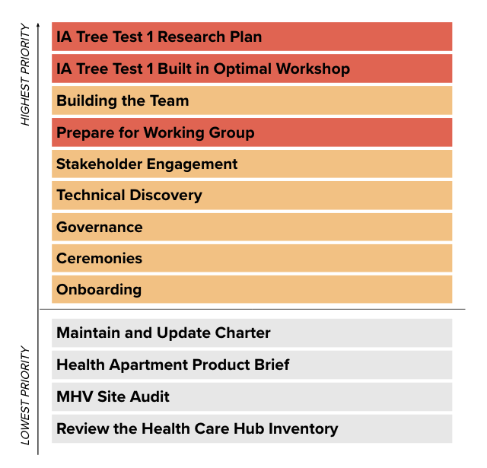
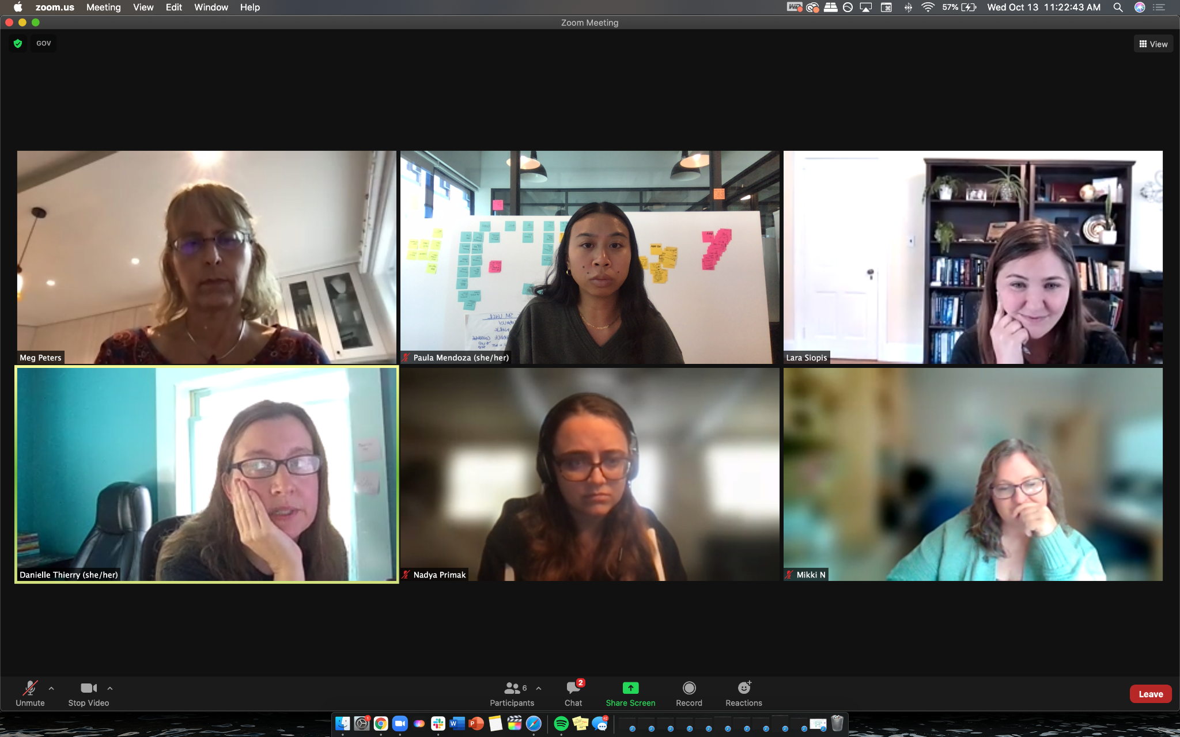
End of Sprint 2 Update
CLIN 0001AB
Sprint 2 focused on designing the research plan, preparing for the Working Group, and wrapping the first cycle of technical discovery, among other goals.
Building off the momentum from Sprint 1, we used our newly built Zenhub backlog to track our progress towards sprint deliverables. We collaboratively further refined the research plan and developed the tree test in Treejack. Our various introductions / conversations with key partners from other teams helped to shape our understanding of the POC. Team feedback and reflection helped us continue to strengthen our process and workflow in real time.

Slide 18
End of Sprint 2 Update (1 of 2)
CLIN 0001AB
The team’s accomplishments this sprint include:
Deep Dive into Research, Discovery, and Proof of Concept
Created the agenda and discussion guide for technical discovery sessions on 10/6.
Conducted and debriefed initial technical discovery session with Michael Chelen to learn about the VA.gov architecture and identify the additional resources, relevant systems, and people that are critical to delivering the POC on 10/7.
Scheduled technical discovery sessions on 10/7.
Created the process for downloading, storing, and conducting synthesis on notes and learnings from discovery discussions on 10/7.
Got write access to VA.gov repos and created new section for health-apartment in va-gov.teams on 10/5.
Began creating the research plan to test the IA and discoverability of content within the Apartment on 10/7.
Updated technical discovery discussion guide in preparation for our meeting with Cory Trimm, the Director of Engineering at OCTO on 10/12.
Conducted technical discovery and introductory meeting with Cory Trimm, learned about VA.gov data and identity and sharing our approach to discovery on 10/12.
Met with Mikki Northuis (Information Architect) and Danielle Thierry (Sitewide Content Lead), made introductions and discussed maintenance and minimization of content and design debt 10/13.
Conducted and debriefed introductory meeting with Dave Conlon (Crew Chief, Public Website), showed the Apartment wireframes and learned more about how to engage the Public Website team on 10/13.
Added issues to the backlog based on technical discovery sessions, including API research, CERNER and Community Care downloads, and Content, Auth, and Navigation downloads, on 10/14.
Synthesized all notes from previous technical discovery sessions and updated our technical discovery mural with key learnings, risks, assumptions, and questions on 10/14.
Documented the current state of our technical discovery findings into a summary on Github outlining our research questions, key findings, who we’ve talked to, recommendations, and further research needed on 10/15.
Co-created and developed the research plan in GitHub on 10/13-10/15.
Converted existing site map into excel format and uploaded it into Optimal Workshop, developed tasks, and built the Treejack test on 10/13-10/15.
Onboard Landing Team and Kickoff Project
Established weekly Problem Solving sessions with MO leadership to provide guidance and steering on 10/6.
Conducted PM Orientation with Shira, learning more about the collaboration cycle and how to engage with the Platform team on 10/7.
Attended Identity Working Group session on 10/7.
Conducted SteerCo meeting with Lauren on 10/7.
Synthesized research from working group sessions on 10/13.
Conducted Apartment Working Group co-creation session with Meg and Lauren to align on objectives on 10/14.
Created Apartment Working Group agenda and materials for review on 10/15.
Attended Mobile Flagship App Sync and Identity Working Group sessions on 10/14.

Slide 19
End of Sprint 2 Update (2 of 2)
CLIN 0001AB
The team’s accomplishments this sprint include:
Problem Definition, Approach, & Sprint Planning
Conducted Sprint 2 Kickoff to launch the sprint aligned on sprint goals (below), priorities, and deliverables, clarify responsibilities, and raise and mitigate risks on 10/6.
Prepared slide for Team of Teams, reviewed with Liz and Jeff S., and presented to Team of Teams on 10/5.
Prepared the Team of Teams slide and conducted a review cycle prior to the Team of Teams meeting on 10/12.
Attended the Team of Teams meeting and presented team updates to the ecosystem on 10/12.
Rescheduled Sprint 2 Demo due to the OCTO offsite on 10/12.
Conducted Backlog Grooming on 10/13.
Conducted Sprint 3 Planning, aligning on high priority goals and epics, on 10/14.
Recruiting, Hiring, and Onboarding
Drink, Nadya, and Jared completed fingerprinting on 10/4-10/7.
Interviewed 3 UX Lead candidates on 10/4-10/7.
Extended an offer to 1 UX Lead on 10/7.
Submitted first monthly Contract Program Management Plan on 10/7.
Scheduled monthly Contractual Reporting Session on 10/7.
Attended Meeting to Discuss FAR 52.223-99 Ensuring Adequate COVID-19 Safety Protocols for Federal Contractors (OCT 2021) (DEVIATION) for CEDAR on 10/13.
Signed and returned Contract Mod on 10/13.
Conducted Contractual Reporting Session to discuss the program, address risks, and review the monthly project management plan on 10/13.
Paula completed fingerprinting on 10/14.
Revised and posted Product Manager Job Description on 10/12
Added 1 product manager candidate to the pipeline 10/13
Added 1 Visual Designer to the pipeline 10/13
Interviewed 1 lead for UX designer 10/14
Completed Drink, Jared, Nadya, and Paula's fingerprints, pending adjudication to begin security clearance process 10/12-10/15
Conducted working session to develop onboarding strategy and execution plan for onboarding new hires onto team on 10/15.

Slide 20
Sprint 2 Links to Work
CLIN 0001AB
IA Tree Test Research Plan
Link here.
IA Tree Test in Treejack
Link here.
Working Group Preparation
Working Group research synthesis and co-creation here.
Technical Discovery
Technical discovery synthesis here.
Technical discovery Mural notes here.

Slide 21
Sprint 2 Acceptance
CLIN 0001AB
Sprint Goals
High: Develop a research plan and identify, prepare, and review all resources needed to conduct IA testing. Continue building the team. Start preparation for the Apartment Working Group session. Conduct introduction and knowledge transfer sessions with the Account team (10/18), Identity team (10/25), and Sitewide team (10/13).
Medium: Create version of existing wireframes in Sketch to use for testing and initial POC environment setup. Build and maintain awareness of the modernized VAMC products. Continue technical discovery. Begin creating the roadmap by layering in the information we have up to this point
Focused Epics
IA Tree Test 1: Research Plan & Build in Optimal Workshop
Building the Team
Prepare for Working Group
Stakeholder engagement
Technical Discovery
Governance
Ceremonies
Onboarding
Deliverables
Name / Description | Acceptance Criteria
IA Tree Test Research Plan | Approved research plan ready for recruitment Research plan will be ready for review and approval by end of sprint rather than approved for recruitment.
IA Tree Test | Tree test designed and built in Treejack
Recruiting Update | Staff roster maintained and updates included in reporting
Working Group Preparation | Team has co-created and prepared for an engaging working group session
Stakeholder Engagement | Meetings with Account, Sitewide and Mikki and Danielle conducted
Technical Discovery | Meetings with Mike Chelen and Cory Trimm conducted
Contract Onboarding / Governance | Contract reports provided on time GitHub repo setup in Healthcare with proper IA Apartment updates are presented at ToT

Slide 22
Show me, don’t tell me: Sprint 3 Demo
2 November 2021
Contract #: 36C10B21D0007
Order #: 36C10B21N00070001

Slide 23
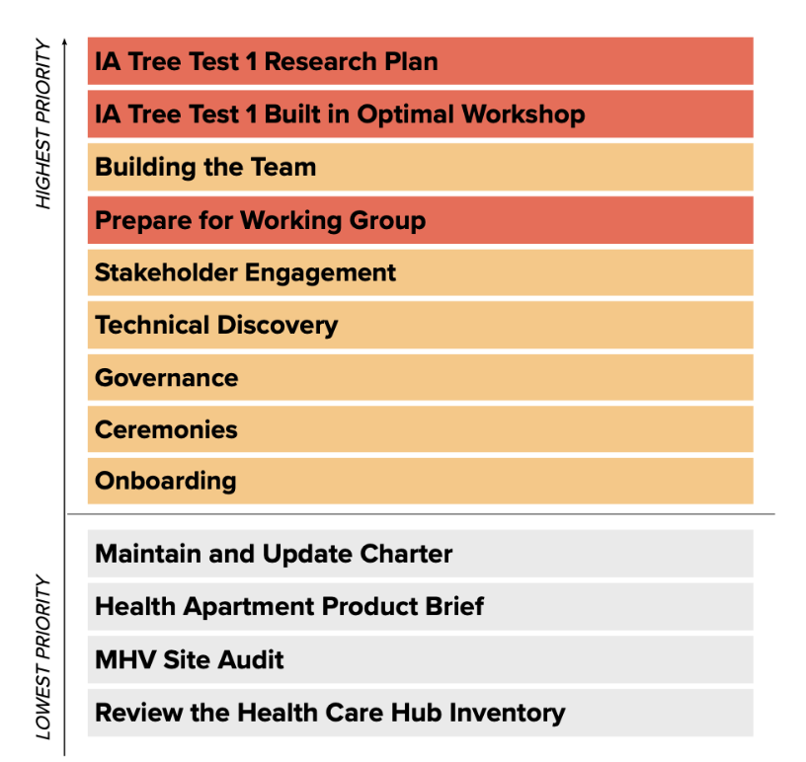
Sprint 3 Approval
CLIN 0001AB
Sprint Dates: 10/20/2021-11/2/2021
Sprint Goals
High: Conduct the first Apartment Working Group and follow-up with actions. Obtain approval for the IA Tree Test 1 Research Plan and Materials. Begin recruiting for the IA Tree Test 1. Create an Apartment Product Outline. Continue to build the team.
Medium: Continue knowledge transfer. Understand the auth/unauth pathways. Continue technical discovery, specifically API research and access to the MHV repo.
Focused Epics
Conduct First Apartment Working Group
Obtain approval for IA Tree Test 1
Recruit for IA Tree Test 1
Conduct IA Tree Test 1
Create Health Apartment Product Outline
Building the Team
Downloads: CERNER, Community Care, Content and Auth, Navigation
Technical Discovery
Stakeholder engagement
Governance
Ceremonies
Onboarding
Deliverables
Name / Description | Acceptance Criteria
Working Group | Working group session conducted Follow-up actions completed
IA Tree Test | Approved research plan ready for recruitment documented in GitHub Tree test recruitment launched Tree test initiated with participants
Stakeholder Engagement | Meeting with Identity team conducted Mobile, Auth, DHM cross team sync attended
Downloads | CERNER, Community Care, Content and Auth, Navigation downloads conducted

Slide 24
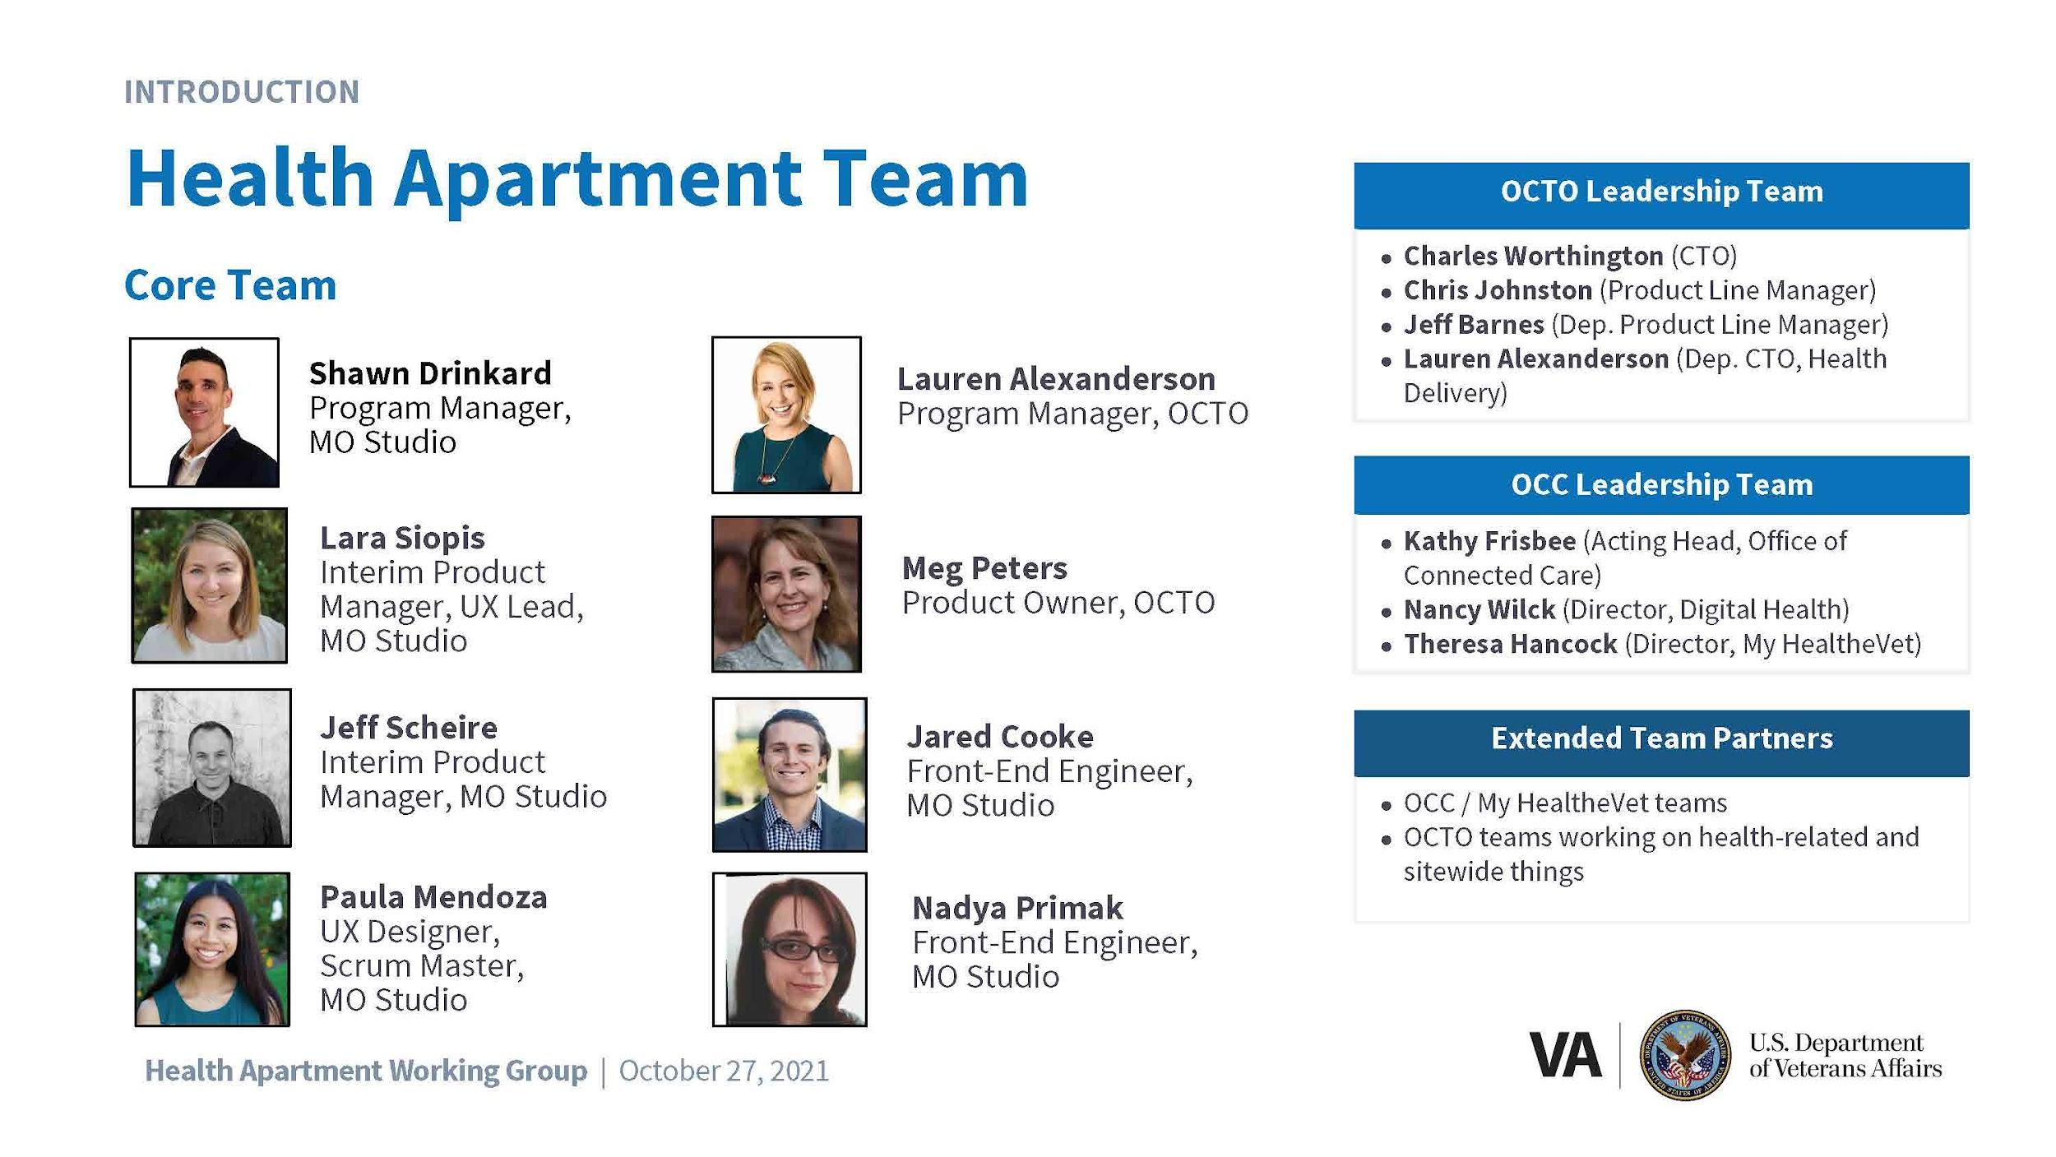
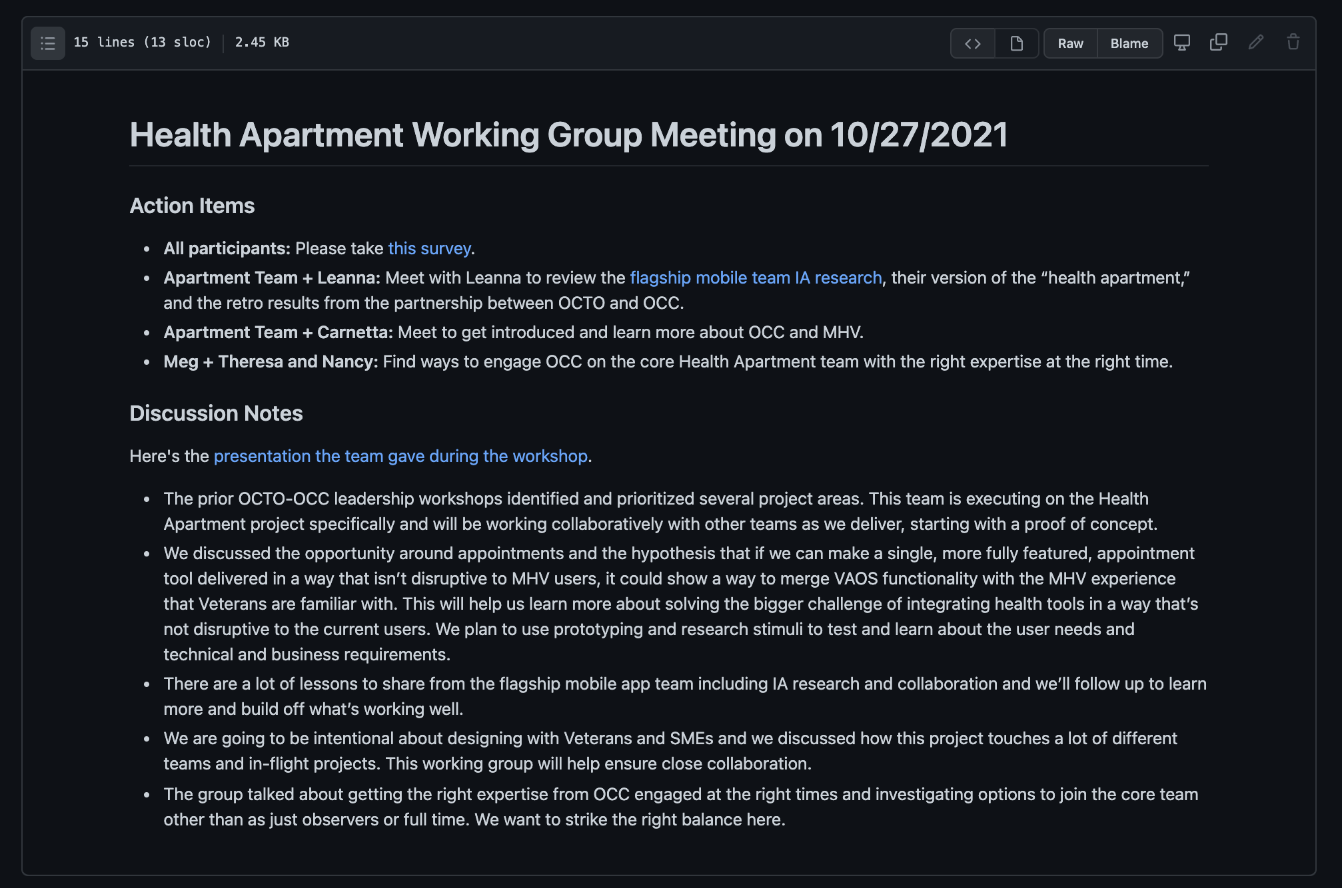
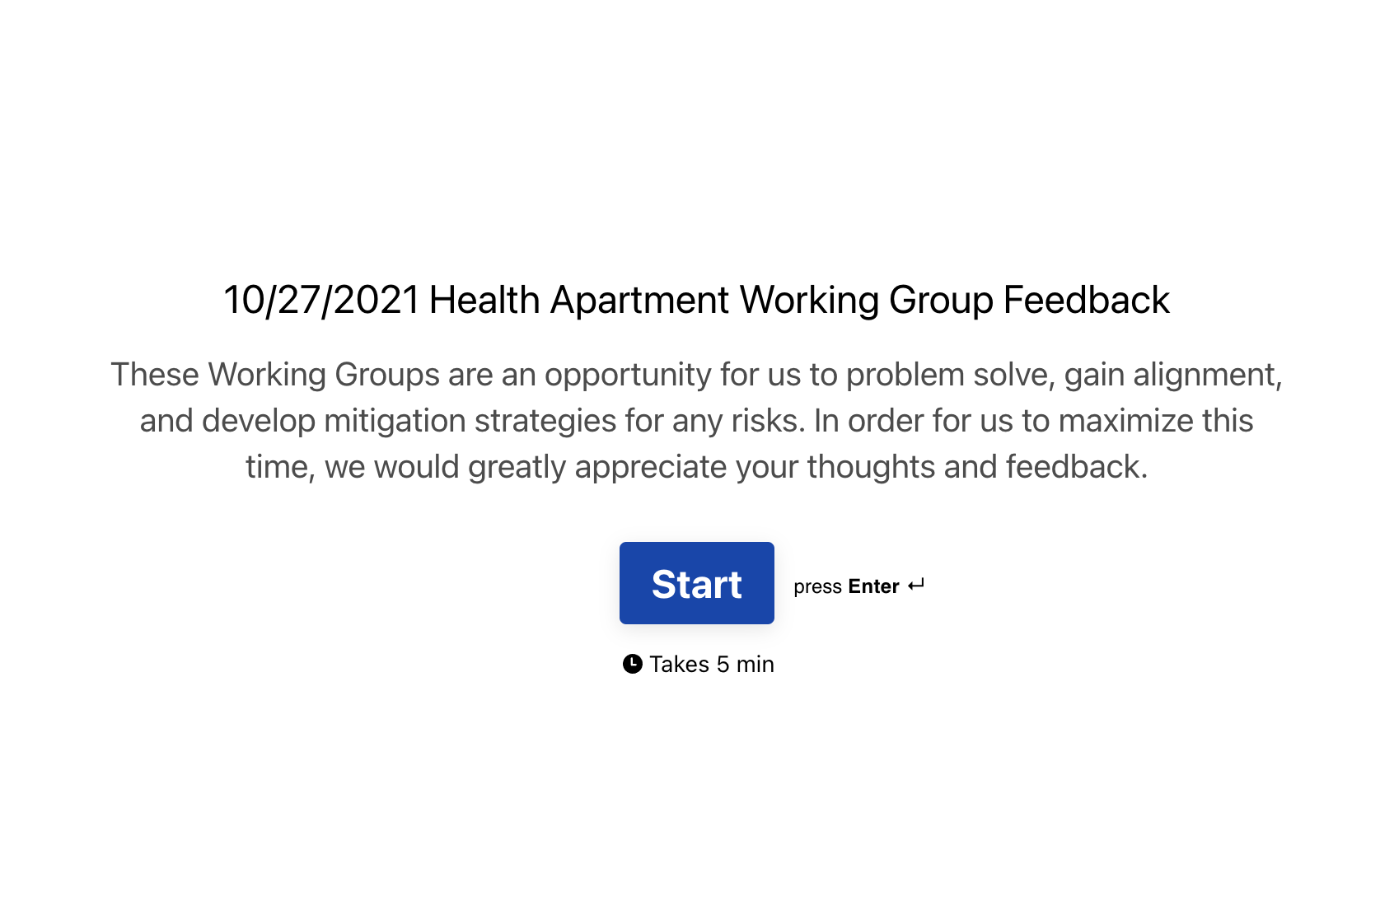
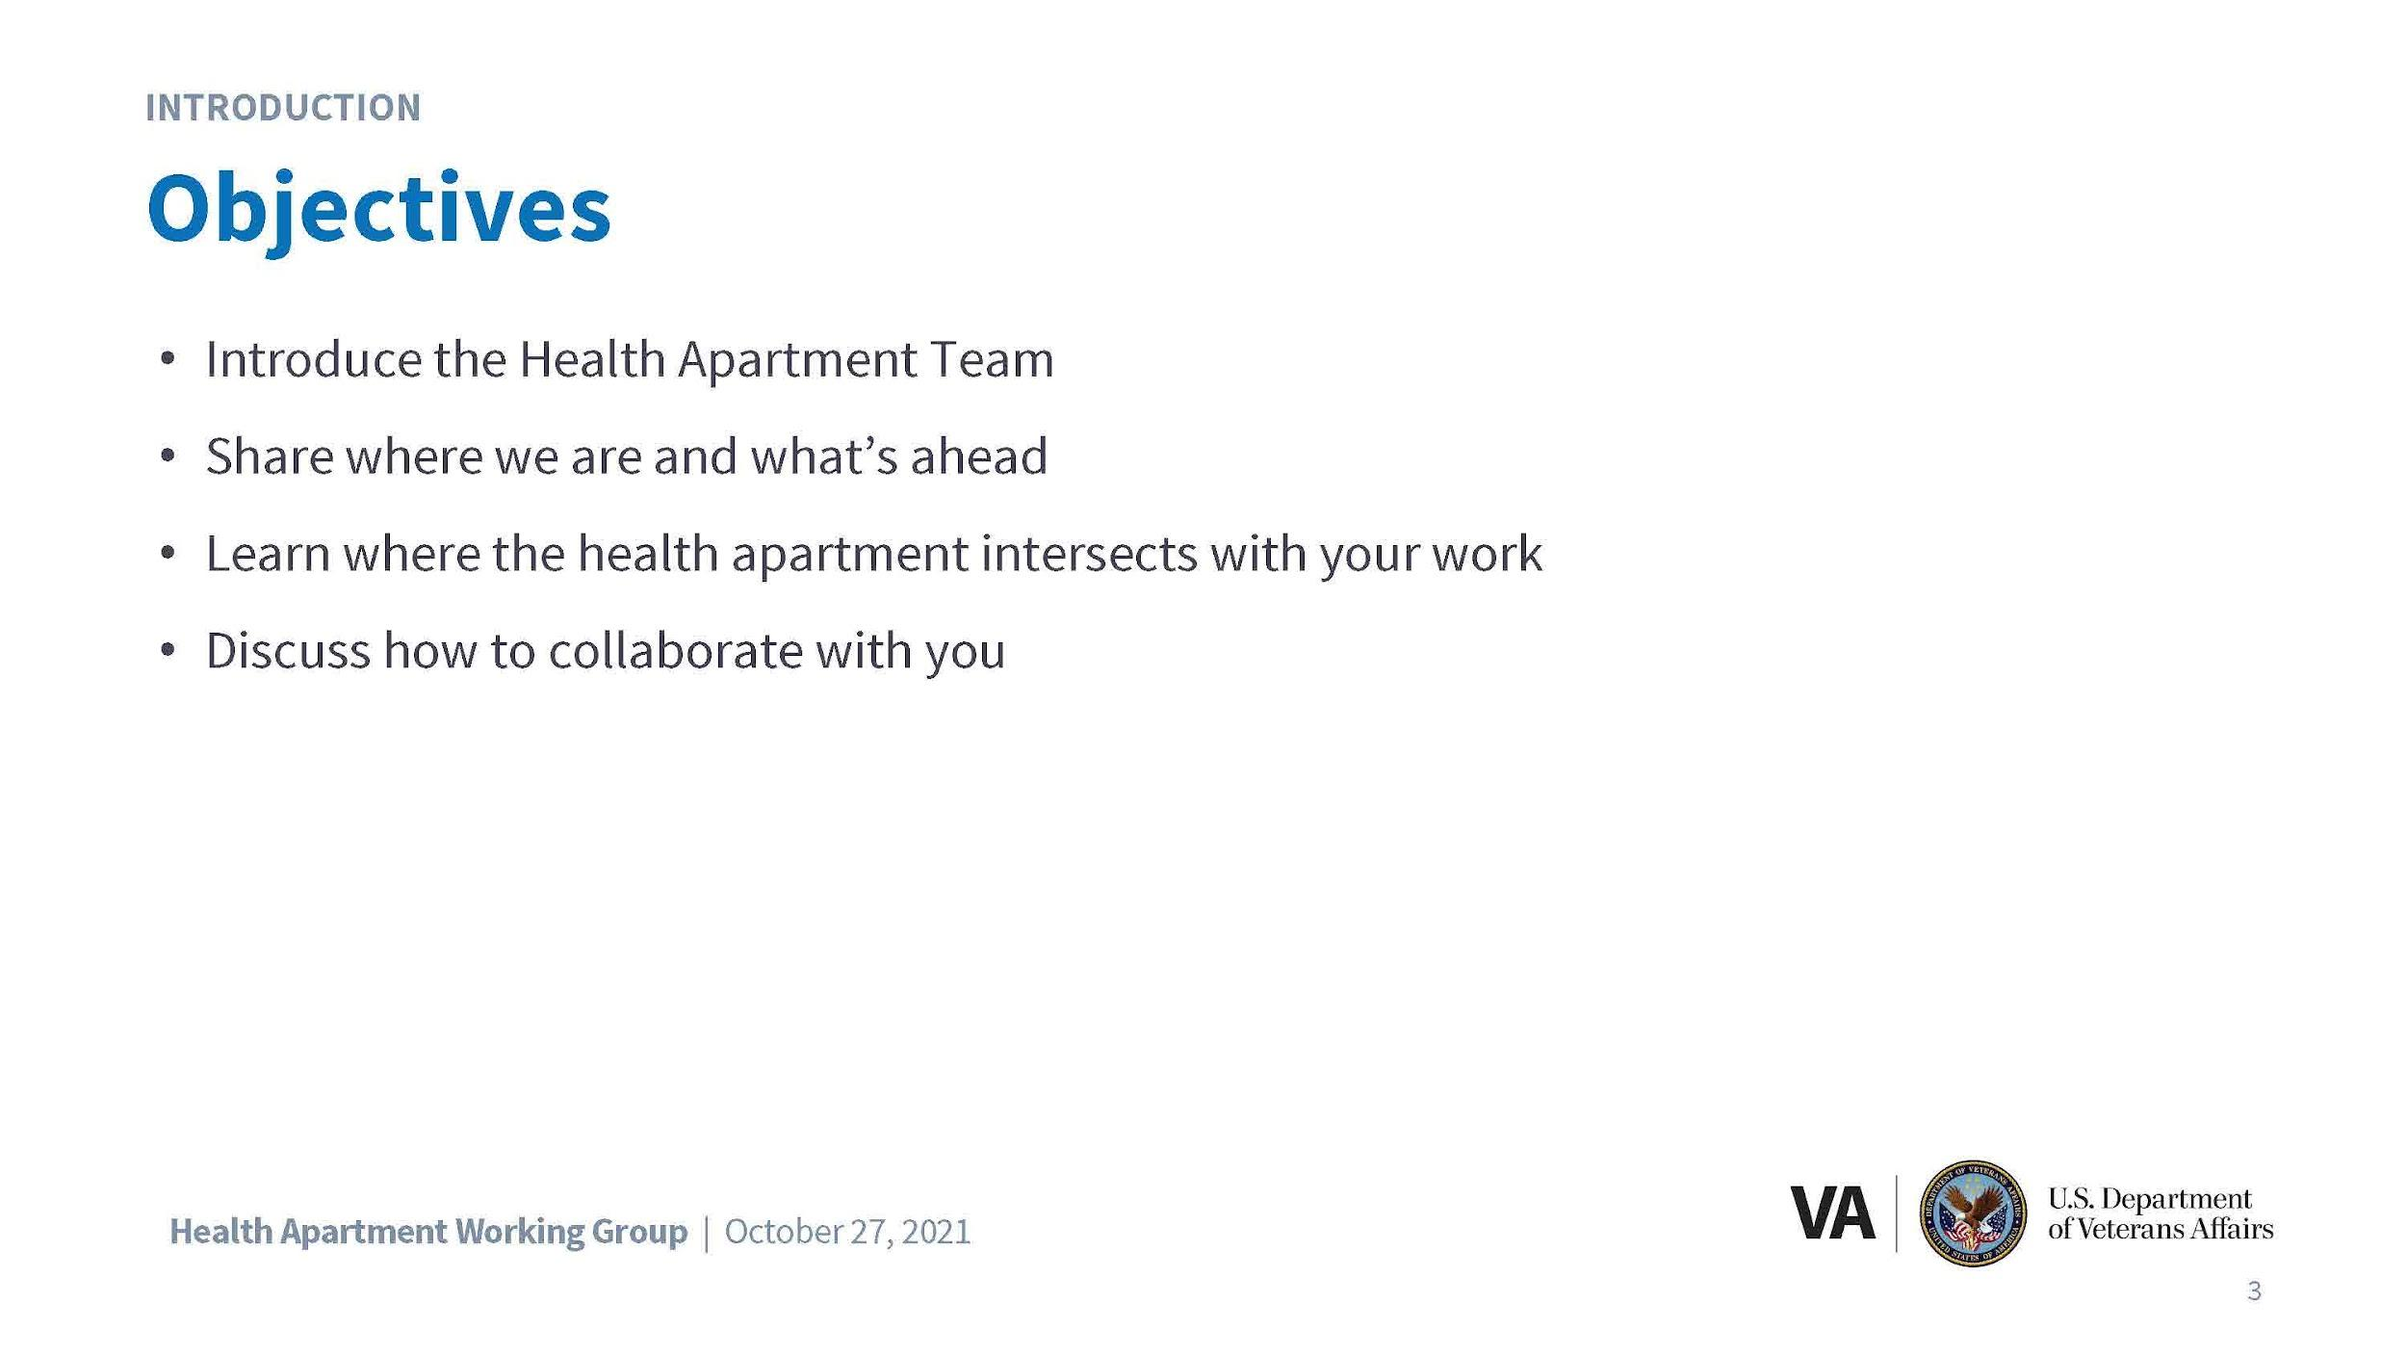


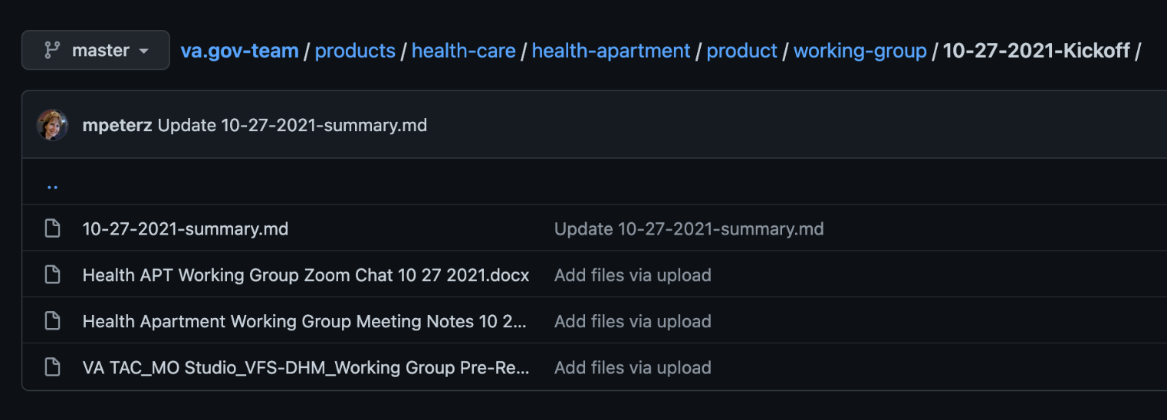
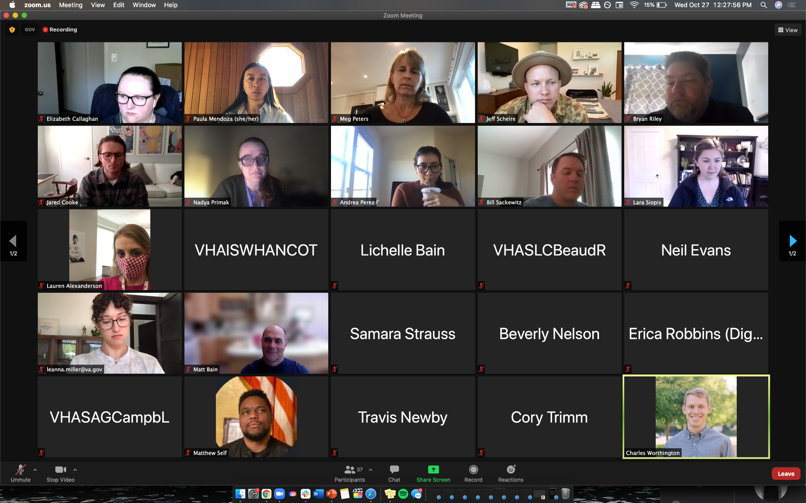
First Apartment Working Group
CLIN 0001AB
Conducted Apartment Working Group #1 with OCTO and OCC.
Accomplished objectives, including: (1) introduced our new Health Apartment Team; (2) shared how we got here, work to date, and what’s ahead; (3) continued to learn how our work builds off and impacts other teams’ work; (4) shared our vision for collaborating
Captured and distributed meeting minutes, follow-up email, gathered feedback via survey, and engaged OCC stakeholders in follow ups / action items.
Materials
Notes
Survey
GitHub Repo
Working Group
View the materials, notes, and survey results here.

Slide 25
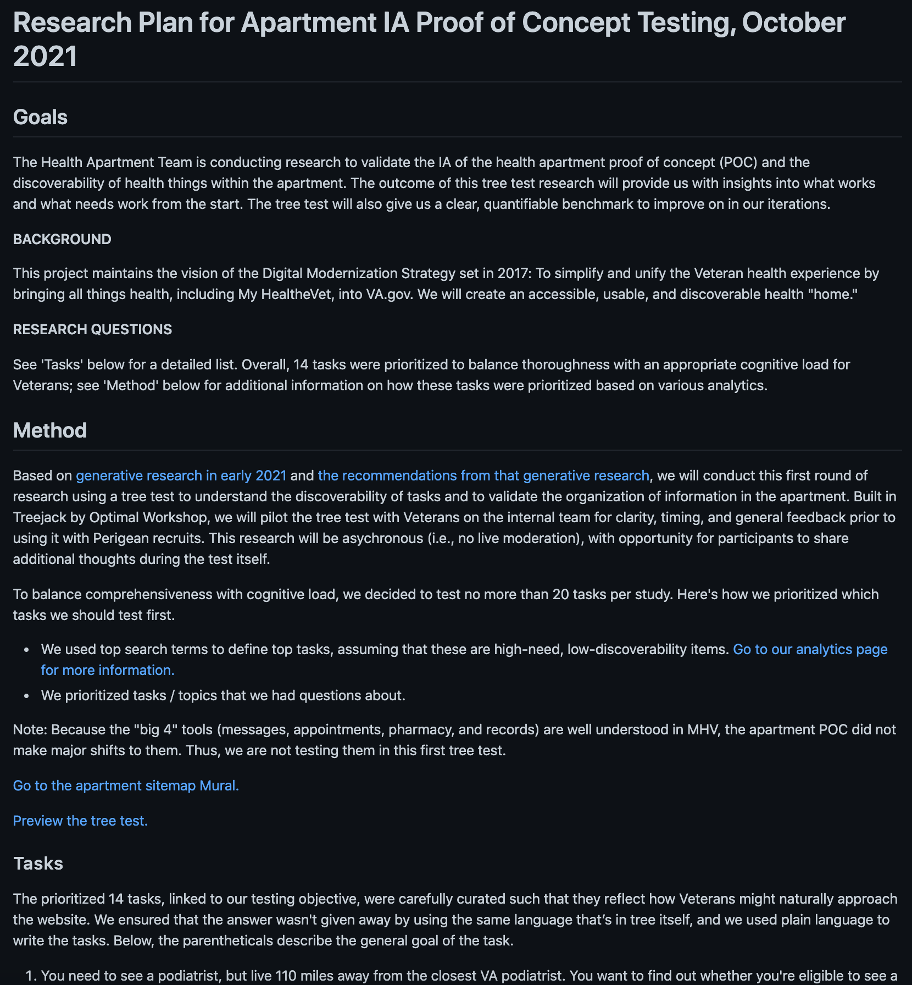
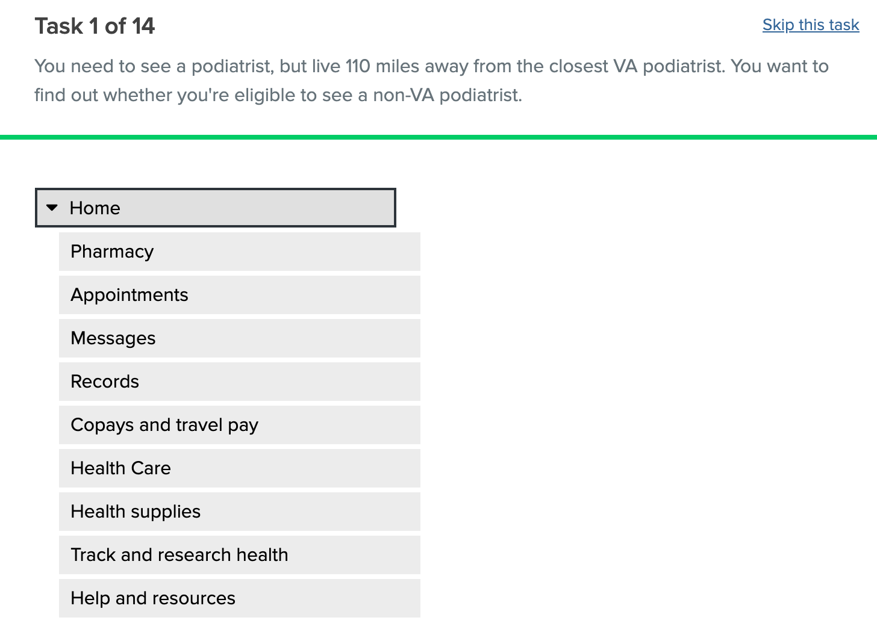
IA Tree Test
CLIN 0001AB
Updated recruiting method and segments.
Iteratively co-created research plan and IA tree test to validate the IA of the POC and the discoverability of health things within the apartment.
Conducted leadership review cycles, iterated to final tree test, and obtained leadership approval.
Submitted recruiting request to Perigean and officially launched tree test.
Created a Slack group with Perigean, COR, and team to manage tree test.
Began testing with 2 of 5 segments and will continue to proactively manage / communicate with Perigean each day on used codes.
Research plan
Treejack test
View the research plan here.
Preview the treejack test here.

Slide 26
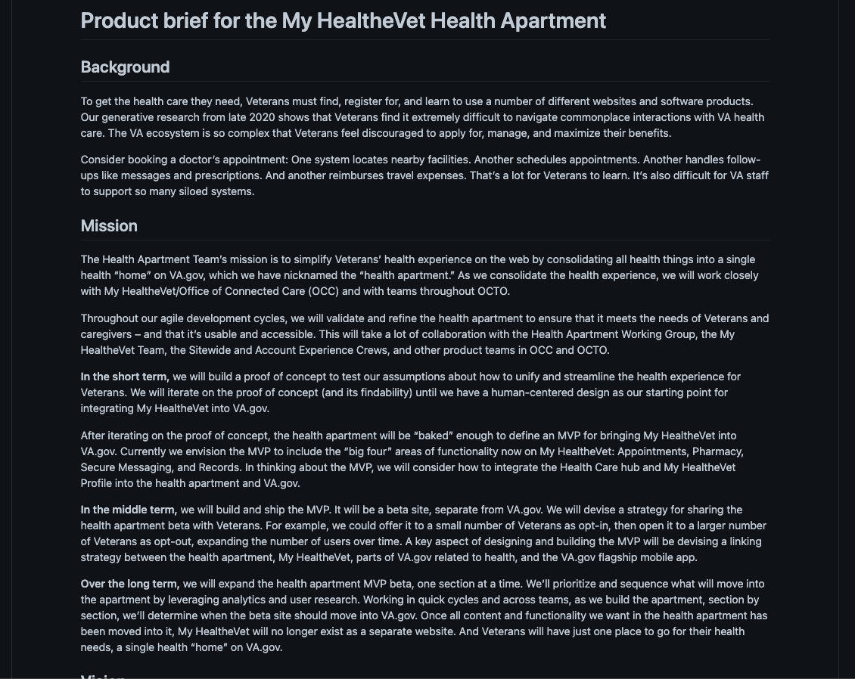
Health Apartment POC Outline
CLIN 0001AB
Drafted the Health Apartment product outline in GitHub and distributed to team feedback and iteration.
Used the Platform team’s template to speed up time to impact.
Planning to kickoff the Collaboration Cycle, using this artifact to share our design intent with the Platform team.
Need review cycles and feedback soonest.
POC Outline
View the Health Apartment POC outline here.

Slide 27
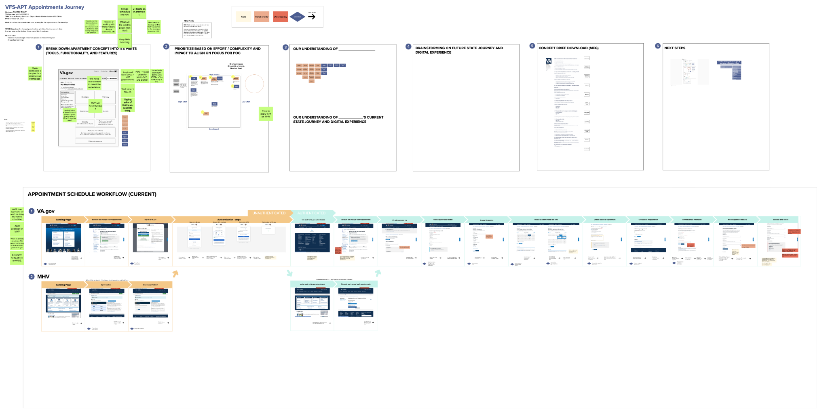
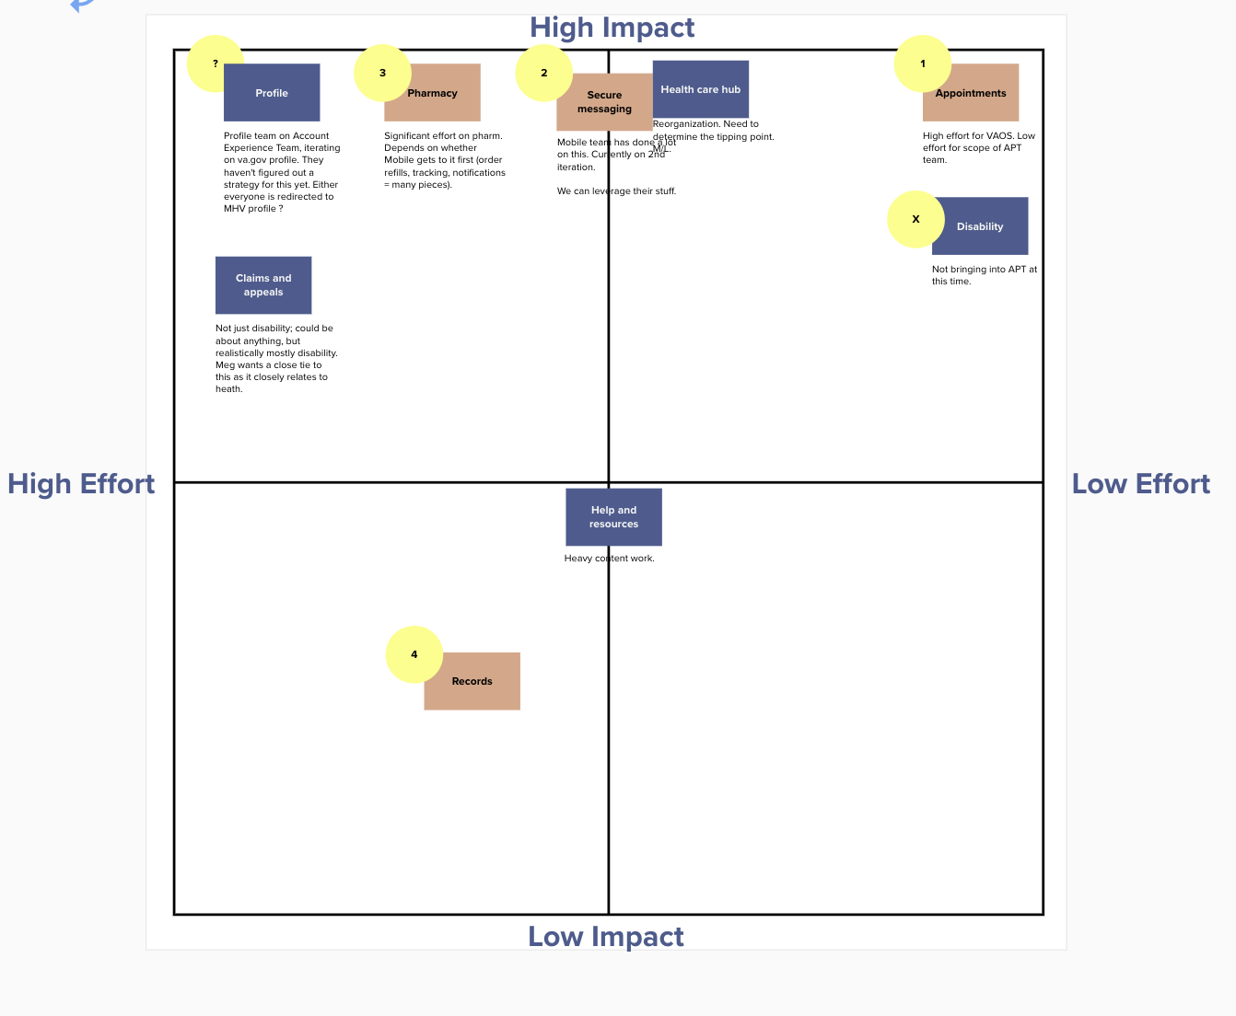
Health Apartment POC Co-Design Workshop
CLIN 0001AB
Mapped current state Veteran journey for appointment scheduling through VA.gov and My HealtheVet.
Created iterative / micro workshops to move from vision / concept to prioritized components; aligned on initial component set for POC design and teased out inputs to sequence product strategy.
Identified components which can be built fastest with highest impact on Veteran experience.
Used current state journey as a diving board for discussion, idea exploration, cross team impacts, and alignment on bounds for POC design—gained clarity on what building the appointments component will entail.
Looking ahead, identified 4 major components which will exist in MVP.
POC Co-Design Workshop
View the working session Mural board here.

Slide 28
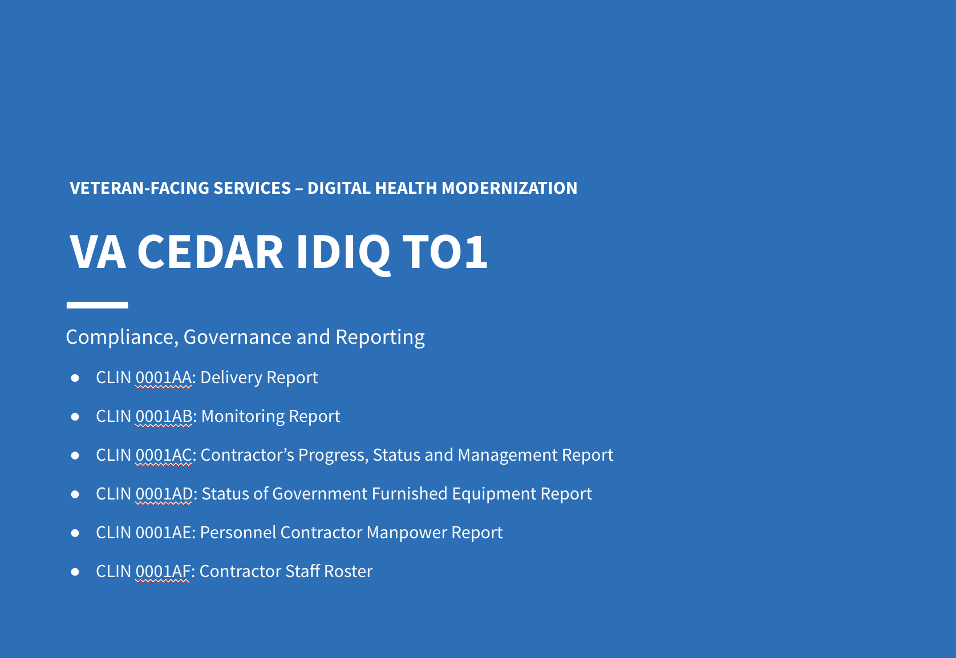
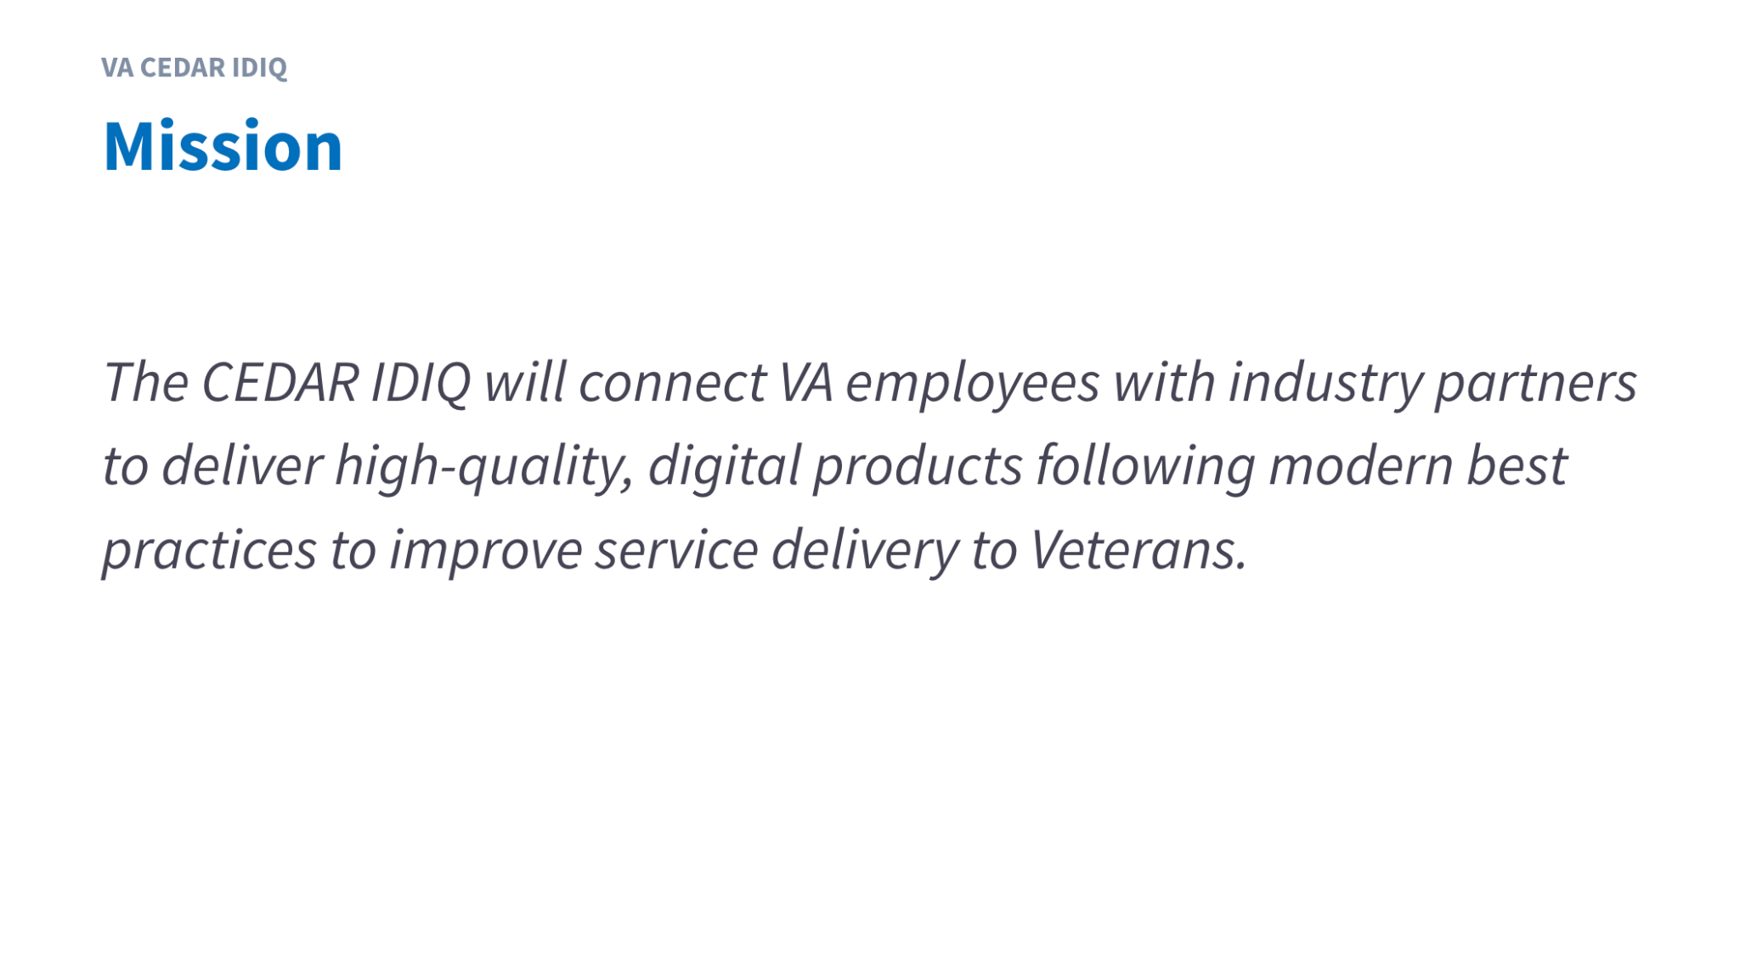

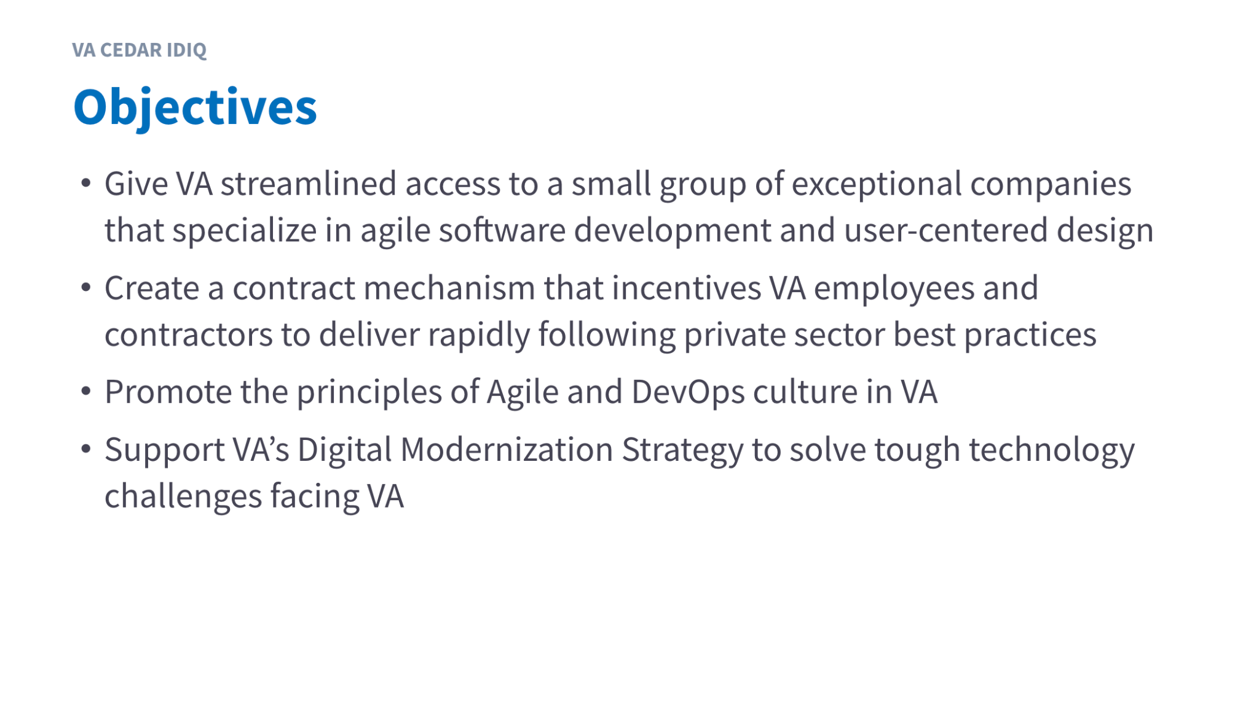
Governance
CLIN 0001AB
Designed materials and conducted initial CEDAR IDIQ and Health Apartment monthly governance and reporting meeting.
Engaged Exec Sponsor, PO, COR, and TAC COs to address contractual requirements.
Identified opportunities to use governance materials across CEDAR task orders.
Identified opportunities to improve transparency and communications on risks and mitigation strategies.
CEDAR IDIQ and Health Apartment Monthly Reporting
View the CEDAR IDIQ and Health Apartment October Monthly Report here. November coming this week!

Slide 29
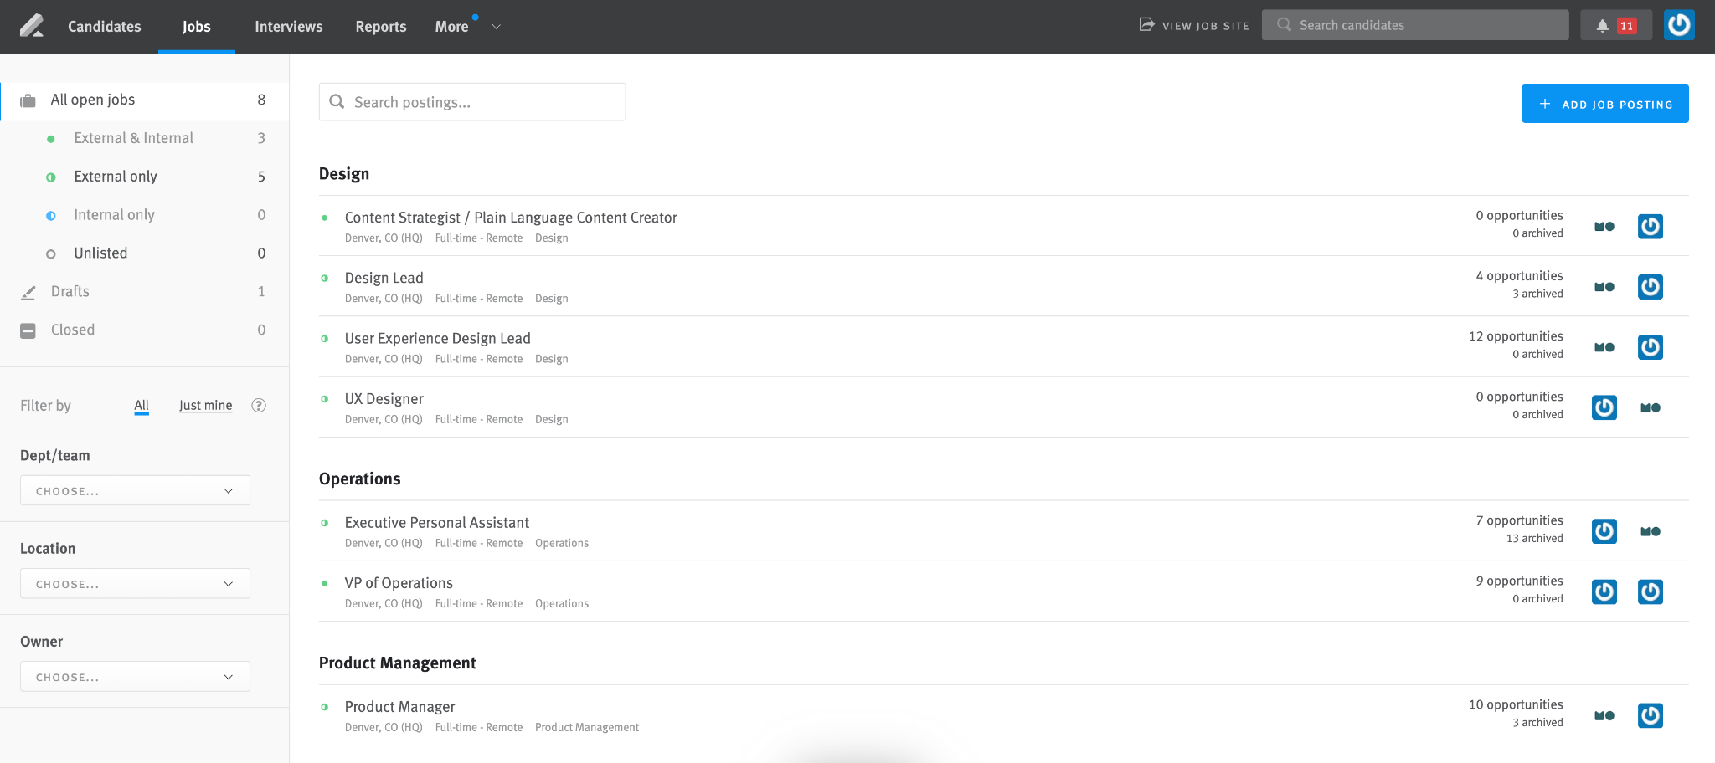
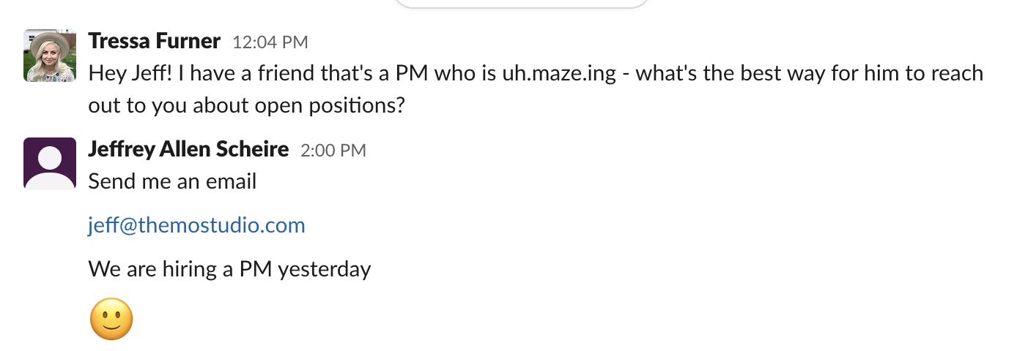
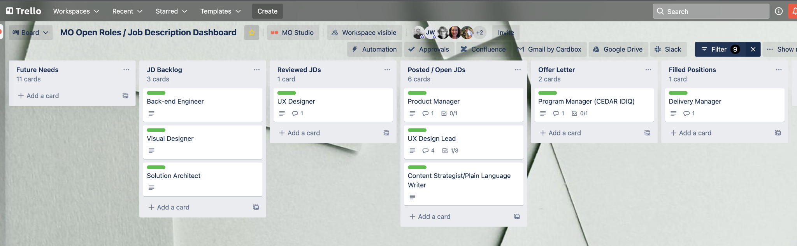
Building the Team
CLIN 0001AB
Aligned with Product Owner on design competencies needed on core team and prioritized focus / JDs.
Launched Lever (Candidate Management System), integrated LinkedIn and WordPress, posted JDs, conducted targeted outreach, and practiced vulnerability by engaging OCTO ecosystem and asking for help.
Moved candidates through the funnel: conducted interviews—(X) Delivery Manager, (XX) UX Design Lead, (XX) UX Designer; extended 4 offer letters: Health (1) Apartment Delivery Manager, (1) Health Apartment Product Manager; (2) CEDAR IDIQ Program Manager.
Created dashboard to openly and transparently provide visibility into open roles / JDs.
Engaged with CEDAR IDIQ teaming partners to staff open JDs.
Lever Candidate Pipeline
Pounding the Pavement
Trello Candidate Dashboard
View the Trello Open Roles / JD Dashboard here.

Slide 30
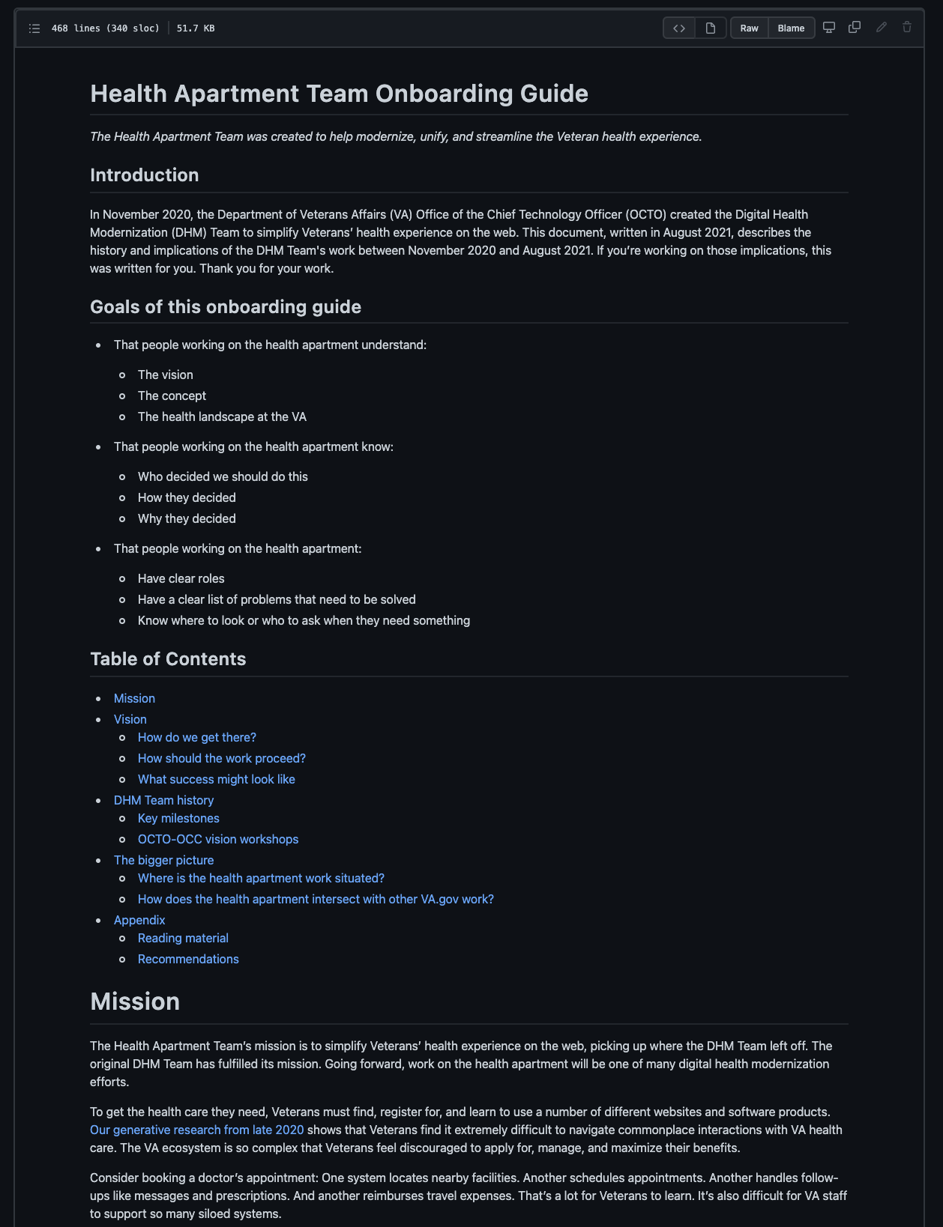
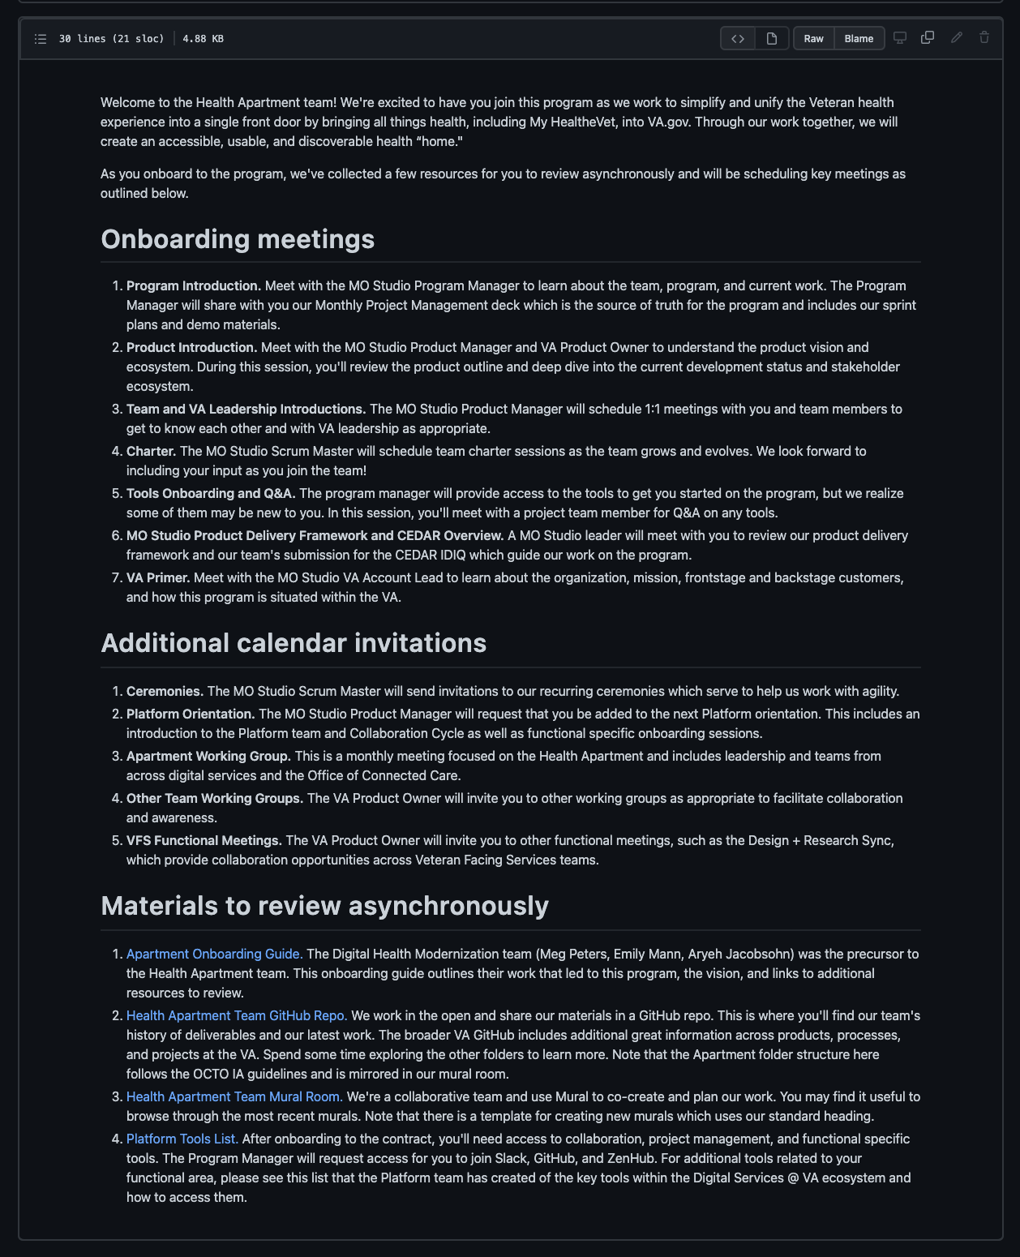
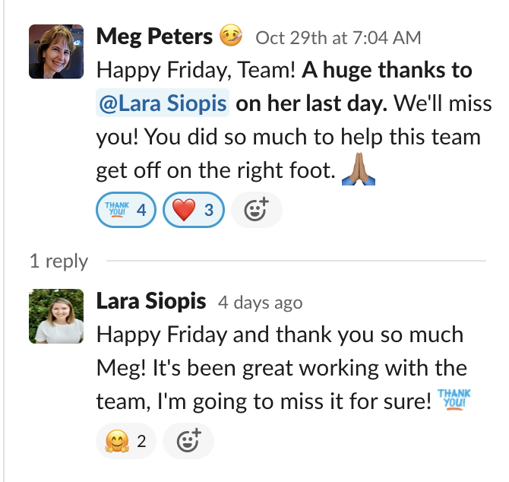
Offboarding and Onboarding the Team
CLIN 0001AB
Conducted onboarding with Heather Vujovich (MO, Delivery Manager) and Tami Corson (ServeAdvisory, Project Manager / Business Analyst).
Added Tracey Mulrooney (OCTO Product Owner) to Scrum meetings.
Mapped onboarding experience for new hires and subcontractors.
Created, tested, and iterated prototypes of Onboarding Guide and Onboarding Journey to address core CEDAR IDIQ pain point “how do we recruit, hire, onboard, and retain our team”.
Said goodbye to a key leader at MO, Lara Siopis.
Onboarding Guide
Onboarding Journey
Saying Goodbye
View the Onboarding GitHub readme here.

Slide 31

Ceremonies
CLIN 0001AB
Audited Agile ceremonies, identified opportunities to reduce meetings and empower team to focus on delivery, and made recommendations to PO.
Shifted sprint planning to beginning of sprint and consolidated with sprint kickoff, consolidated demo and retro, evolved retro into backlog prioritization with leaders (Exec Champion, PO, PM), and identified additional opportunities (e.g., right size and harden backlog to focus on leadership priorities—POC Design) starting Sprint 4.
Evolved calendar invites.
Monday | Tuesday | Wednesday | Thursday | Friday
11/1 | 11/2 POC and MVP Check-in: 9am ET Sprint 3 Demo & Retro: 11am ET Sprint 4 Backlog Prioritization: 2pm ET | 11/3 Admin / Fall Cleaning Monthly Contract PM Plan Update: 2pm ET | 11/4 Sprint 4 Planning: 10am ET | 11/5
11/8 | 11/9 POC and MVP Check-in: 9am ET | 11/10 | 11/11 | 11/12
11/15 | 11/16 POC and MVP Check-in: 9am ET Sprint 4 Demo & Retro: 11am ET Sprint 5 Backlog Prioritization: 12pm ET | 11/17 Sprint 5 Planning: 10am ET | 11/18 | 11/19
11/22 | 11/23 POC and MVP Check-in: 9am ET | 11/24 Apartment Working Group: 2pm ET | 11/25 | 11/26
11/29 | 11/30 POC and MVP Check-in: 9am ET Sprint 5 Demo & Retro: 11am ET Sprint 6 Backlog Prioritization: 12pm ET | Sprint 6 Planning: 4pm ET

Slide 32
End of Sprint 3 Update (1 of 2)
CLIN 0001AB
The team’s accomplishments this sprint include:
Apartment Working Group
Co-created Apartment Working Group objectives and agenda with Meg and Lauren and documented synthesis in GitHub on 10/18-10/20.
Drafted email to Apartment Working Group participants and sent out the objectives and agenda on 10/20.
Drafted and reviewed Apartment Working Group slides during MO Problem Solving sessions, getting feedback from MOVE leadership (reachback support across our CEDAR team) on 10/20.
Revised Apartment Working Group slides and shared with Meg and Lauren on 10/21.
Began to reconcile feedback on 10/22.
Kicked off the Apartment Working Group with our first session on 10/27. The work for this included co-creation with Meg and Lauren, presentation prep, gathering input from our CEDAR go to market partners, creating a participant survey, debriefing, and synthesizing key takeaways and action items.
Sent follow up email with notes, slides, and link to feedback survey.
Research and Discovery
Discussed using the MHV newsletter as a recruiting tool for the IA tree test if offered by OCC on 10/20.
Submitted IA tree test research plan for review by Meg and Lauren on 10/21.
Updated technical discovery tool (Mural) on 10/21.
Began to develop materials for research synthesis on 10/22.
Met with Ben to share learnings and get feedback on current technical discovery plan and developed a plan to limit the scope of the technical discovery sessions on 10/22.
Conducted debrief session immediately following our session with Ben to capture key learnings, actions items, and key questions to ask in the upcoming technical discovery sessions on 10/22.
Scheduled CERNER download session on 10/22.
Visualized the current state user journey for Appointments in Mural following a team member's actual experience through the process.
Met with Meg to deep dive into Navigation, Content, Authentication, Homepage design, Community Care, and Cerner creating a deeper shared understanding and capturing notes and additional references in Mural.
Launched recruitment for the IA Tree Test - our first phase of research on discoverability within the Apartment. Our research plan is in GitHub and the Tree Test can be previewed in Optimal Workshop.
Proof of Concept
Continued to synthesize learnings and POC definition in Mural on 10/19-10/21.
Followed up with Barry to request access to the MHV repo on 10/20.
Prioritized the use cases for the POC based on impact and level of effort.
Cross-team Collaboration
Attended Identity Working Group on 10/21.
Continuing to engage across OCTO teams with the VA.gov Platform and Apps Weekly Design + Content + Research Sync, Team of Teams, and Identity Working Group.
Met with the Identity team on 10/25.

Slide 33
End of Sprint 3 Update (2 of 2)
CLIN 0001AB
The team’s accomplishments this sprint include:
Recruiting, Hiring, and Onboarding
Aligned on hiring priorities with a focus on Product Manager, Design Lead, and UX Design Lead
Conducted staffing strategy sessions to discuss needed roles, anticipated gaps, and required skills on 10/19 and 10/21.
Revised and posted UX Design Lead Job Description on 10/22.
Conducted follow up interview with one Design Lead applicant on 10/22; total of 4 active applicants.
Continued PIV onboarding; next week we will submit security forms to VA SharePoint that will trigger EQIP, and make relevant modification to access.
Prioritized roles and skill sets to focus our hiring. Priorities are:
Product manager — top priority (This person might run scrum ceremonies.)
UX design lead
UX designer
RE: the 2 UX designers - Need these skills: user research (priority), service design (priority). Visual design skills needed, too.
Delivery manager (This person is a writer, communicator, organizer. Skilled in internal comms and product documentation. Not running the scrum.)
Content strategist + plain language writer (This person supports Meg in working on IA and content strategy.)
Back-end engineer (MO will probably pull from Pluribus for now.)
Approach and Sprint Planning
Conducted Sprint 3 Kickoff to launch the sprint aligned on sprint goals, priorities, and deliverables, clarify responsibilities, and raise and mitigate risks on 10/20.
Adjusted our sprint ceremonies to more efficiently prioritize and plan the work.
Added an administrative clean-up day to tackle any remaining onboarding tasks, access issues, or other recurring roadblocks.
Governance
Submitted Sprint 2 demo slides and links to work within the monthly report to minimize the creation of extra materials and received acceptance from Meg on 10/19.
Received approval for Sprint 3 on 10/19.
Invoiced Sprint 2 on 10/19.

Slide 34
Sprint 3 Acceptance
CLIN 0001AB
Sprint Dates: 10/20/2021-11/2/2021
Sprint Goals
High: Conduct the first Apartment Working Group and follow-up with actions. Obtain approval for the IA Tree Test 1 Research Plan and Materials. Begin recruiting for the IA Tree Test 1. Create an Apartment Product Outline. Continue to build the team.
Medium: Continue knowledge transfer. Understand the auth/unauth pathways. Continue technical discovery, specifically API research and access to the MHV repo. Added a medium priority goal during sprint kickoff to investigate Codepen for testing the Health Apartment IA with participants who use screen readers.
Focused Epics (Approval)
Conduct First Apartment Working Group
Obtain approval for IA Tree Test 1
Recruit for IA Tree Test 1
Conduct IA Tree Test 1
Create Health Apartment Product Outline
Building the Team
Downloads: CERNER, Community Care, Content and Auth, Navigation
Technical Discovery
Stakeholder engagement
Governance
Ceremonies
Onboarding
Deliverables
Focused Epics (Acceptance)
√ Conduct First Apartment Working Group
√ IA Tree Test (Obtain Approval, Recruit, Conduct)
√ Conduct Health Apartment POC Co-Design Workshop(s)
√ Create Health Apartment Product Outline
√ Build the Team, Onboard New Team Members, Built Prototype of Scalable Onboarding Process and Enabling Tools
√ Research—Technical Discovery, Downloads, and Stakeholder Engagement (CERNER, Community Care, Content and Auth, Navigation)
√ Monthly Governance and Reporting
√ Evolve and Optimize Agile Ceremonies
Name / Description | Acceptance Criteria
Working Group | √ Working group session conducted √ Follow-up actions completed
IA Tree Test | √ Approved research plan ready for recruitment documented in GitHub √ Tree test recruitment launched √ Tree test initiated with participants
Stakeholder Engagement | √ Meeting with Identity team conducted √ Mobile, Auth, DHM cross team sync attended
Downloads | √ CERNER, Community Care, Content and Auth, Navigation downloads conducted

Slide 35
Show me, don’t tell me: Sprint 4 Demo
16 November 2021
Contract #: 36C10B21D0007
Order #: 36C10B21N00070001

Slide 36
Sprint 4 Approval (1 of 2)
CLIN 0001AB
Sprint Dates: 11/3/2021-11/16/2021
Sprint Goals: Make demonstrable and meaningful progress on delivering the Health Apartment POC design. Recruit, hire, and onboard both FTEs (prime or subcontract) to address open roles and bring in additional capabilities to move the work forward in the interim. Develop a product strategy / roadmap to guide us to POC design and MVP design and development.
Priority | Epic - User Story | Acceptance Criteria
High | POC Design: Create product roadmap and backlog Deliverable: Refined product roadmap, owners aligned with user stories / issues | Working sessions on Product Roadmap scheduled and conducted with PO and capability leaders across broader MO team. Activities, components and features prioritized to drive team from vision to POC Design provided by VA PO. Working sessions conducted to turn provided activities into a visual Product Roadmap with assigned owners of artifacts. Product roadmap driving team to POC Design developed, socialized, and approved by VA PO; team aligned around roadmap and focus. Product backlog in ZenHub evolved including epics, user stories and issues, acceptance criteria, and sizing to drive team to POC Design.
High | POC Design: Create POC Design prototypes (low level of fidelity) Deliverable: Design Prototype (low-fidelity); 18 frames | VA PO and design lead engaged to deep dive current state of POC design, wireframes, and transition ownership to MO. POC components, features, and UX prioritized building off of work done to date by design lead and VA.gov flagship mobile app team. Low level fidelity prototypes (Procreate software) created for ~18 frames of prioritized components, features, and UX to gather input and align on design intent efficiently (i.e., build to learn): (1) POC landing page; (2) health care homepage; (3-11) authenticated and (12-21) non-authenticated top landing pages from sitemap including Pharmacy, Messages, Appointments, Records, Copays and Travel Pay, Health Care, Health Supplies, Track and Research Health, Health and Resources. Feedback gathered during APT POC & MVP weekly check-in and demo and captured in backlog to be incorporated into mid level of fidelity prototypes.
Medium | POC Design: Discovery and exploration on navigation system Deliverable: Key insights and opportunities for navigation system captured in shareable artifact (e.g., Mural board). | Navigation system content reviewed (e.g., VA.gov healthcare section, navigation mural, design system, PA CMS, VA.gov healthcare benefit hub). Key insights and design opportunities captured in Mural board and shared with product team; insights and opportunities fed into backlog for mid-level fidelity prototypes.
Notes:
Evolve GitHub Repo and documentation templates for POC
Test low-fidelity prototype with users

Slide 37
Sprint 4 Approval (2 of 2)
CLIN 0001AB
Sprint Dates: 11/3/2021-11/16/2021
Priority | Epic - User Story | Acceptance Criteria
Medium | Collaboration Cycle: Product Definition Document Deliverable: Product Definition Document reviewed and suggestions and edits provided. | Product Definition Document reviewed and actionable feedback provided from core and extended team members (capability SMEs). Feedback consolidated and Product Definition document evolved by VA PO. Impact on product roadmap including POC Design and MVP Design and Development determined and added to backlog for future consideration. VA PO engaged to determine owner and governance of Product Definition Document moving forward.
Medium | Collaboration Cycle: Initiation Deliverable: Initiate Collaboration Cycle through VA PO | Research collaboration cycle and captured epics and user stories for product backlog. Collaboration Cycle started by VFS Product Owner submitting design intent ticket. Working session with VA PO to align on Collaboration Cycle next steps and clear owners scheduled.
Notes:
Evolve GitHub Repo and documentation templates for POC
Test low-fidelity prototype with users

Slide 38
Sprint 4 Mid-Sprint Add On
CLIN 0001AB
Epic - User Story | Fibonacci Seq. | Acceptance Criteria | Notes | Date
POC Design: Determine impacts to POC design through Tree test results | N/A | Validate study result parameters compliance Review and synthesize objective & subjective data from Tree Testing Report impacts to POC design development team | Low priority add-on, will address if excess capacity or return to Product backlog. Interim results will be added to low-fidelity frames. | 11/9/21

Slide 39
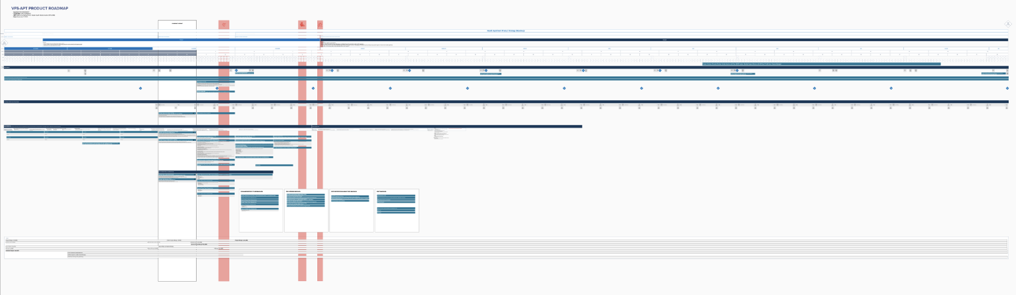
POC Design: Create product roadmap and backlog
CLIN 0001AB
Deliverable: Refined product roadmap, owners aligned with user stories / issues
Scheduled and conducted Product Roadmap working sessions on with VA PO and delivery team.
Prioritized activities, components, and features to drive team from vision to POC Design provided by VA PO.
Built off CEDAR VFS-DHM proposed approach and VA Digital Service Handbook (including Collaboration Cycle and MVP definition guidance) into Product Roadmap.
Assigned owners to epics to facilitate alignment and accountability on the cross-functional delivery team.
Socialized Product Roadmap and refined based on VA PO feedback here.
Aligned team on plan / epics to drive to POC Design and MVP Development (e.g., epics, governance, stakeholder engagement via Working Group, CEDAR program, staffing across roadmap for entirety of PoP).
Evolved Zenhub product backlog to Mural during this design phase (i.e., deferred reliance on ZenHub until development phase) to support alignment on epics, acceptance criteria, and sizing.

Slide 40
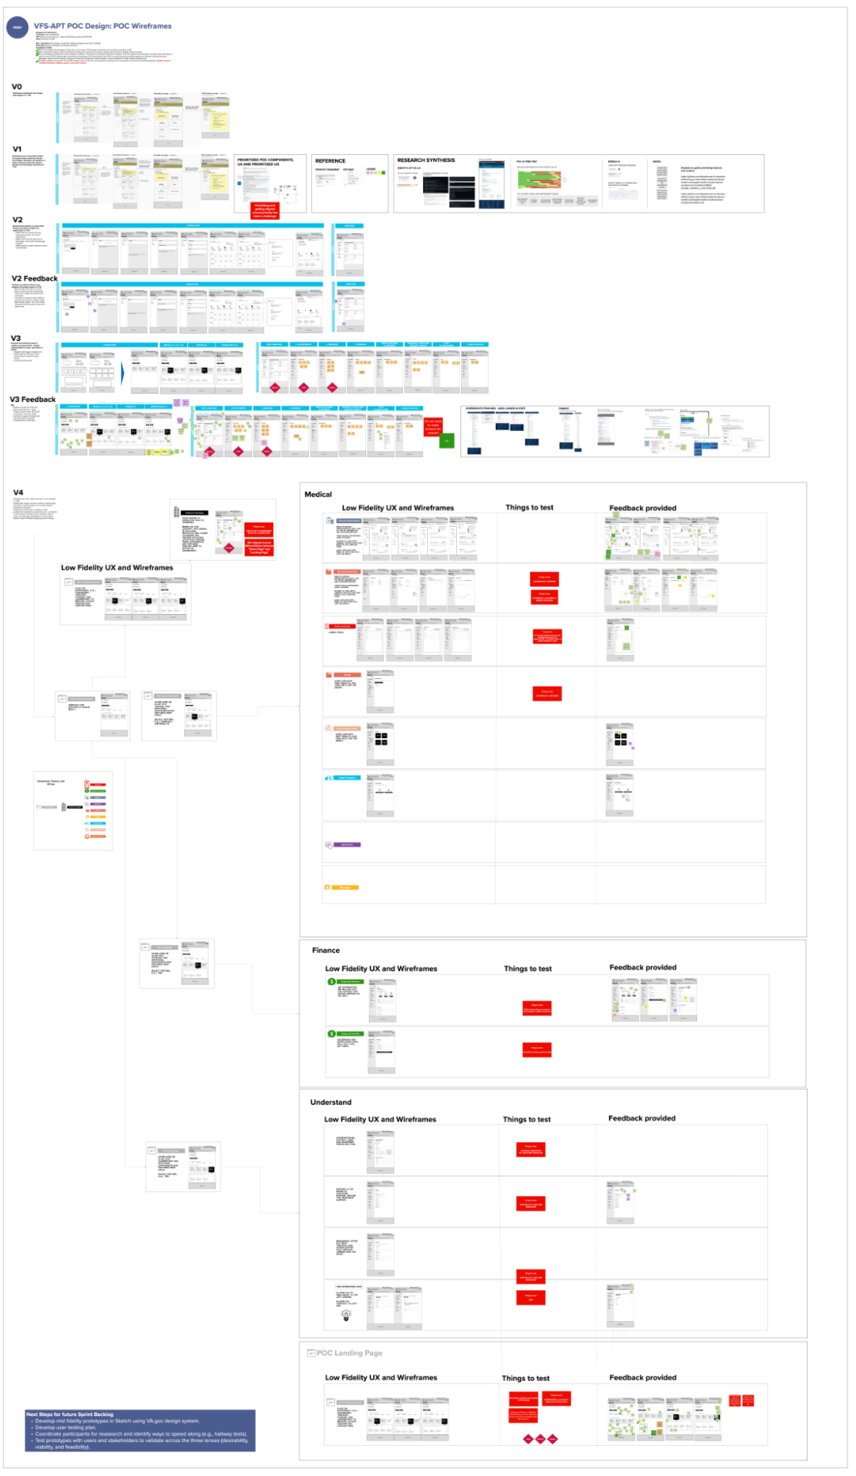
POC Design: Create POC Design prototypes (low level of fidelity)
CLIN 0001AB
Deliverable: Design Prototype (low fidelity); 18 frames
Transitioned POC design wireframes from VA Design Lead to MO to own and drive forward.
Gathered input from VA PO and VA Design Lead on reprioritization of POC components, features, and UX.
Infused insights from preliminary IA tree test results as well as additional secondary research studies (VA.gov Mobile App card sort) into concepts and designs.
Brainstormed solutions to address design questions and user feedback and pain points.
Created 27 wireframes for authenticated and non-authenticated low fidelity wireframes (view here).
Gathered feedback from VA PO and VA Design Lead during multiple sessions (including POC and MVP weekly check-in and demo).
Incorporated feedback into iterative low fidelity wireframes and captured additional feedback as backlog items for mid fidelity wireframes.
Mapped out initial user experience flow of future-state vision to accompany wireframes.

Slide 41
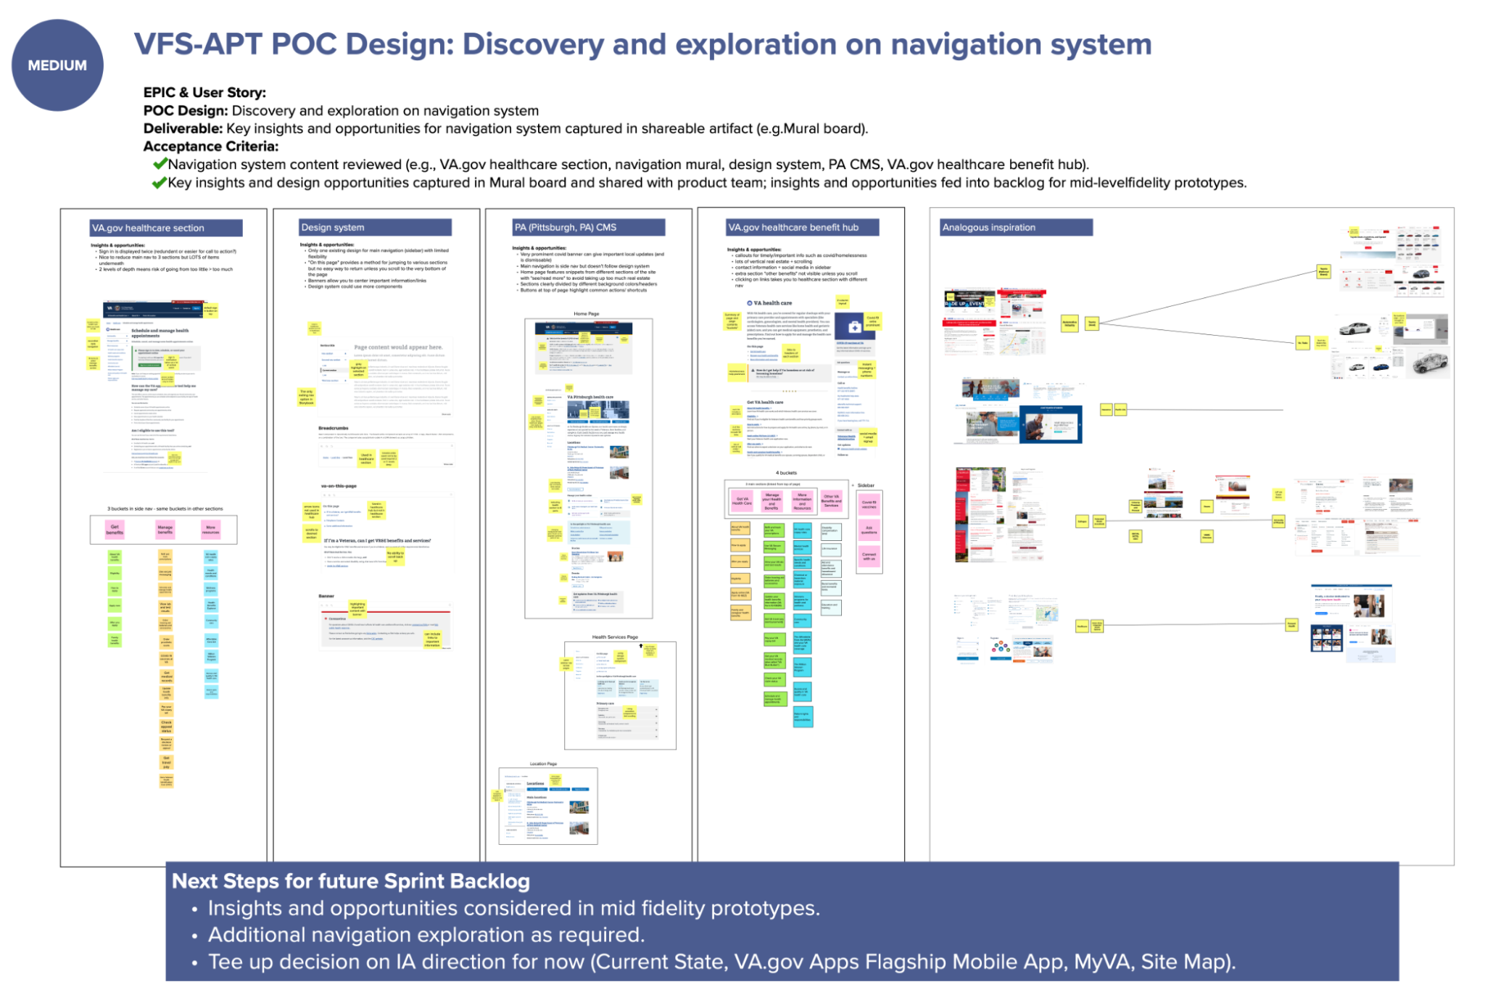
POC Design: Discovery and exploration on navigation system
CLIN 0001AB
Deliverable: Key insights and opportunities for navigation system captured in shareable artifact (e.g., Mural board)
Reviewed Navigation system content from relevant sites, including VA.gov healthcare section, navigation Mural, VA design system, PA CMS, and VA.gov health care benefit hub.
Identified patterns, insights, and design opportunities to infuse into mid fidelity prototypes, and captured in a Mural board and backlog shared with product team.
Researched analogous use cases to inspire navigation design and potential solutions.

Slide 42
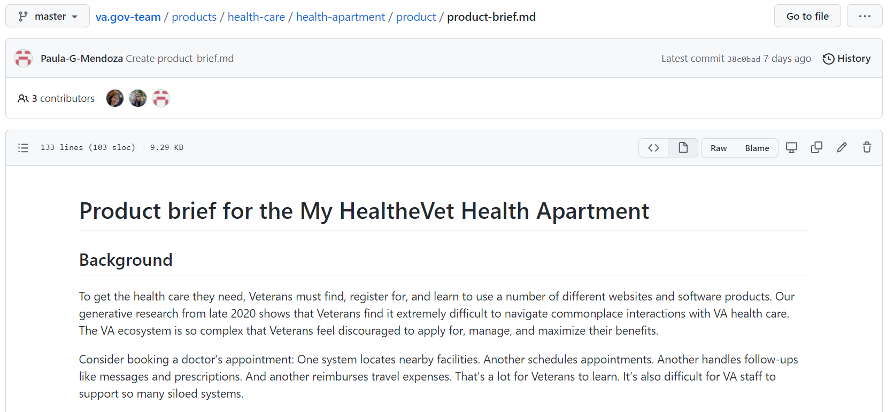
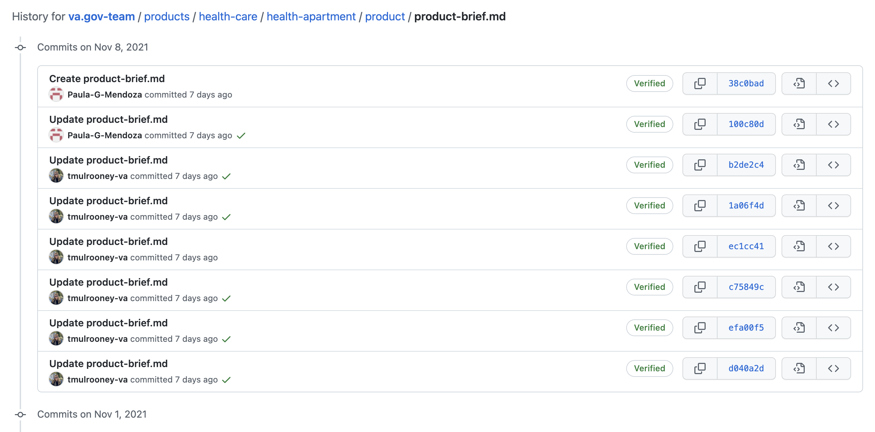
Collaboration Cycle: Product Definition Document
CLIN 0001AB
Deliverable: Product Definition Document reviewed and suggestions and edits provided
Reviewed Product Brief (i.e., Product Outline) and provided actionable feedback.
Consolidated feedback and evolved document by VA PO.
Determined and mapped its impact (and that of the associated Collaboration Cycle) on product roadmap, including POC Design and MVP Design and Development.

Slide 43
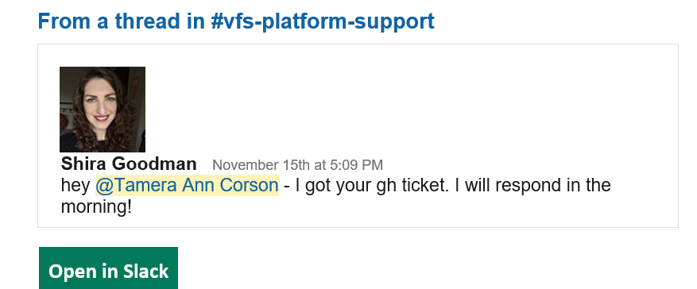
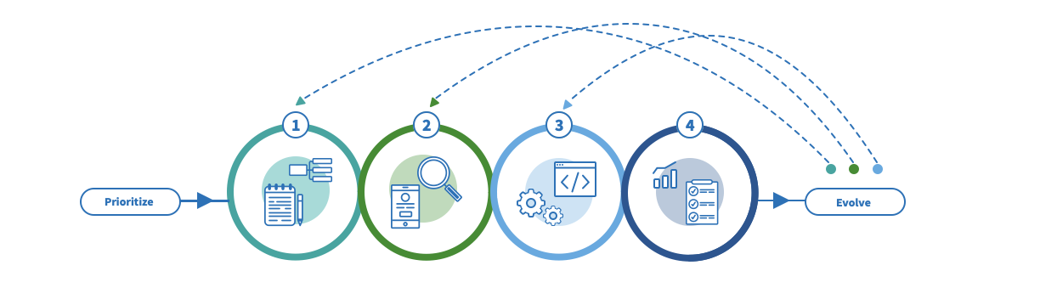
Collaboration Cycle: Initiation
CLIN 0001AB
Deliverable: Initiate Collaboration Cycle through VA PO
Researched Collaboration Cycle on VA Platform website and reflected epics in product roadmap.
Completed and submitted Pre-Collaboration Cycle Kick Off questionnaire.
Initiated Collaboration Cycle via ticket submission on #vfs-platform-support Slack channel and GitHub; ticket #32870)
Scheduled working session with VA PO in next sprint to align on Collaboration Cycle next steps, owners, and governance (including Product Outline document).

Slide 44
End of Sprint 4 Update
CLIN 0001AB
The team’s accomplishments this sprint include:
Design Prototype
Wireframes transitioned from VA.gov lead designer on ~11/8
Synthesized and incorporated insights and opportunities outlined by VA.gov lead designer (feedback and guidance to date), previously conducted research (primary and secondary), and IA test on ~11/9
Brainstormed solutions to mature POC Design and address insights and opportunities on 11/9
How may we (HMW) make the unauth and auth experiences unique and reduce redundancy?
HMW show 1) just the right level of information, and 2) with minimal page transfers?
HMW design to support Veterans' action-orientedness?
Feedback provided by VA.gov lead designer and product owner on 11/10
Must include information in unauth.
Sign in needs to be on landing page.
Continue to update IA based on tree test results.
Confusion on product team's ability to diverge from solutions outlined in Site Map, Design System, etc. led to fruitful discussion with VA product owner and design lead.
Brainstormed solutions based on insights and opportunities + deeper understanding on scope / guardrails on 11/12.
Designed with bigger changes to IA.
HMW organize information more clearly? (See IA research results above.)
Included red diamonds
Version 3 produced, representing 27 auth/unauth low-fidelity wireframes.
Additional iterative feedback provided for consideration in next sprint.
Feedback gathered during APT POC & MVP weekly check-in and demo and captured in backlog to be incorporated into mid level of fidelity prototypes (multiple sessions including workshop, feedback session, and asynch reviews).
Navigation System
Navigation system content reviewed (e.g., VA.gov healthcare section, navigation mural, design system, PA CMS, VA.gov healthcare benefit hub).
Key insights and design opportunities captured in Mural board and shared with product team; insights and opportunities fed into backlog for mid-level fidelity prototypes.
Collaboration Cycle
Researched collaboration cycle and captured epics and user stories for product backlog.
Completed and submitted pre-collaboration cycle kick-off questionnaire
Collaboration cycle initiated by Project Manager through submission of request and validated by platform support receipt
Product Definition
Product Definition Document reviewed and actionable feedback provided from core and extended team members (capability SMEs).
Feedback consolidated and Product Definition document evolved by VA PO.
VA PO engaged to determine owner and governance of Product Definition Document moving forward.
Roadmap
Working sessions on Product Roadmap scheduled and conducted with PO and capability leaders across broader MO team.
Activities, components and features prioritized to drive team from vision to POC Design provided by VA PO.
Working sessions conducted to turn provided activities into a visual Product Roadmap with assigned owners of artifacts.
Product roadmap driving team to POC Design developed, socialized, and approved by VA PO; team aligned around roadmap and focus.
Product backlog in Mural evolved including EPICS, user stories and issues, acceptance criteria, and sizing to drive team to POC Design. Use of ZenHub backlog deferred during design phase.

Slide 45
Sprint 4 Acceptance
CLIN 0001AB
Sprint Dates: 11/4/2021-11/16/2021
Sprint Goals: Make demonstrable and meaningful progress on delivering the Health Apartment POC design. Recruit, hire, and onboard both FTEs (prime or subcontract) to address open roles and bring in additional capabilities to move the work forward in the interim. Develop a product strategy / roadmap to guide us to POC design and MVP design and development.
Focused Epics (Approval)
POC Design: Refine product roadmap and backlog
POC Design: Create POC design prototypes (low fidelity)
POC Design: Discovery and exploration on navigation system
Collaboration cycle: Product definition document
Collaboration Cycle: Initiation
Mid-Cycle Requests
POC Design: Determine impacts to POC design through tree test results.
Deliverables
Focused Epics (Acceptance)
√ POC Design: Refine product roadmap and backlog
√ POC Design: Create POC design prototypes (low fidelity)
√ POC Design: Discovery and exploration on navigation system
√ Collaboration cycle: Product definition document
√ Collaboration Cycle: Initiation
Mid-Cycle Requests
√ POC Design: Determine impacts to POC design through tree test results. Synthesized and infused impacts on low fidelity POC designs using IA tree test preliminary results.
Name / Description | Acceptance Criteria
Refined Product Roadmap | √ Working group session conducted √ Roadmap and Backlog evolved to reflect foci and owners of artifacts √ Socialized and aligned team with roadmap
Prototype (low-fidelity) 18 frames | √ Conducted deep dive with VA PO and design lead on current state of POC wire frames for transition to MO ownership √ 27 low fidelity authenticated and non-authenticated frames developed in Procreate √ Feedback gathered during APT POC & MVP weekly check-in and captured in backlog
Navigation system mural | √ Navigation system content reviewed √ Key insights and design opportunities captured in Mural and fed into backlog for mid-fidelity prototypes
Product Definition edits | √ Product definition document reviewed, feedback provided, document evolved Impact of definition to roadmap, POC design, MVP Design and development added to backlog
Collaboration cycle initiated | √ Collaboration cycle initiated by PM; working session TBD by Platform Support

Slide 46
Show me, don’t tell me: Sprint 5 Demo
30 November 2021
Contract #: 36C10B21D0007
Order #: 36C10B21N00070001

Slide 47
Sprint 5 Approval (1 of 3)
CLIN 0001AB
Sprint Dates: 11/17/2021-11/30/2021
Sprint Goals: Pushed Health Apartment POC Design homepage to mid fidelity. Created communication asset, POC Design PPT, and aligned stakeholders. Updated POC Design Site Map and
iterated low fidelity Health Apartment POC Design homepage into mid fidelity incorporating IA tree test synthesized feedback. Captured MyVA overlap with Health Apartment POC Design homepage in POC Design PPT.
Priority | Epic: User Story | Acceptance Criteria
High | POC Design: Synthesize IA tree test and infuse learnings into Site Map, POC Design PPT, and concepts to address user feedback in Health Apartment POC Design homepage | Synthesized IA tree test and captured insights, opportunities, and potential solutions to address IA tree test user feedback in both POC Design PPT and Site Map Mural Socialized and discussed IA tree test insights, opportunities, and potential solutions to address user feedback using POC Design PPT, Site Map Mural, and Health Apartment POC Design to guide discussion with VA PO and VA Design Lead prior to Sprint 5 demo Captured feedback and requested changes to Health Apartment POC Design, POC Design PPT, and Site Map Mural in the POC Design PPT (requested changes to be considered in future sprints) Demonstrated work to VA Executive Sponsor in Sprint 5 demo Deliverable: Developed POC Design PPT and captured learnings, impacts, and recommendations Deliverable: Updated Site Map Mural (v4)
High | POC Design: Iterate Health Apartment POC Design homepage wireframes from low to mid level of fidelity for both authenticated and unauthenticated user experiences | Iterated Health Apartment POC Design unauthenticated and authenticated homepage wireframes from low fidelity (output of previous sprint) to mid fidelity using Sketch for both mobile and desktop versions Iterated Health Apartment POC Design unauthenticated and authenticated homepage wireframes for both mobile and desktop versions based on user feedback from IA tree test If required, created 1+ Health Apartment POC Design unauthenticated and authenticated homepage concepts to address IA tree test feedback to be used in future user testing Identified and documented user feedback, impact on components and features on Health Apartment POC Design homepage, and concepts / potential solutions to address feedback in POC Design PPT Socialized and discussed work with VA PO and VA Design Lead prior to Sprint 5 demo Captured feedback and requested changes to be considered in future sprints Demonstrated work to VA Executive Sponsor in Sprint 5 demo Deliverable: Captured learnings, impacts/changes, concepts to address user feedback, and recommended next steps in POC Design PPT Deliverable: Iterated Health Apartment POC Design homepage wireframes including updates based on IA tree test

Slide 48
Sprint 5 Approval (2 of 3)
CLIN 0001AB
Priority | Epic: User Story | Acceptance Criteria
High | POC Design: Review MyVA and prepare for future OCTO engagement with MyVA team | Conducted deep dive into MyVA dashboard value proposition (e.g., key features and benefits) Identified and documented impacts and overlaps of Health Apartment POC Design and MyVA product (e.g., notifications) in POC Design PPT Defined objectives, questions and created activities to guide future discussion with MyVA team Socialized and discussed objectives, questions and activities with VA PO and VA Design Lead prior to Sprint 5 demo Captured feedback and requested changes to be considered in future sprints Demonstrated work to VA Executive Sponsor in Sprint 5 demo Deliverable: Captured learnings and impacts in POC Design PPT
High | POC Design: Synthesize navigation system research and identify additional impacts on Health Apartment POC Design | Synthesized research into navigation system and uncovered insights, design opportunities, and impacts on Health Apartment POC Design (e.g., homepage and landing pages for auth and not auth key features) Identified and documented impacts on Health Apartment POC Design homepage in POC Design PPT Identified and documented considerations on Health Apartment POC Design to be used during design of Health Apartment POC Design key features in future sprints in POC Design PPT Socialized and discussed considerations on Health Apartment POC Design to be used during design of Health Apartment POC Design key features in future sprints using POC Design PPT with VA PO and VA Design Lead prior to Sprint 5 demo Captured feedback and requested changes to be considered in future sprints Demonstrated work to VA Executive Sponsor in Sprint 5 demo Deliverable: Captured learnings and impacts in POC Design PPT including impacts on homepage and considerations for Health Apartment POC Design features to be designed in future sprints
Med | POC Design: Define and align on clear acceptance criteria for Health Apartment POC Design and capture in POC Design PPT | Created agenda, materials, and activities to conduct workshop to align on clear acceptance criteria for Health Apartment POC Design Conducted workshop with Executive Sponsor, VA PO, and VA Design Lead to align on clear acceptance criteria for Health Apartment POC Design and prioritized and sequenced plan to deliver Health Apartment POC Design feature (i.e., Health Apartment POC Design wireframe creation order) Captured written approval for Health Apartment POC Design from VA PO in email Reviewed Product Roadmap and incorporated changes based on refined acceptance criteria for Health Apartment POC Design Socialized and discussed Product Roadmap with VA PO and VA Design Lead prior to Sprint 5 demo Captured feedback and requested changes to be considered in future sprints Demonstrated Product Roadmap with VA Executive Sponsor during Sprint 5 demo Deliverable: Updates to POC Design PPT

Slide 49
Sprint 5 Approval (3 of 3)
CLIN 0001AB
Priority | Epic: User Story | Acceptance Criteria
Low | POC Design: Infuse approach to developing Health Apartment POC Design with VA.gov user research / testing processes, methods, and tools | Reviewed VA.gov user research processes, methods, and tools Incorporated VA.gov user research processes, methods, and tools into POC Design PPT (i.e., used these processes, methods, and tools to capture feedback and changes to Health Apartment POC Design homepage) Created user stories in Product Roadmap to incorporate VA.gov user research processes, methods, and tools into workflow in future sprints (e.g., GitHub README, research findings deck, etc.) Socialized and discussed incorporation of VA.gov user research / testing processes, methods, and tools with VA PO and VA Design Lead prior to Sprint 5 demo Captured feedback and requested changes to be considered in future sprints Demonstrate incorporation of VA.gov user research / testing processes, methods, and tools to VA Executive Sponsor in Sprint 5 demo Deliverable: Captured learnings and impacts in POC Design PPT and incorporated VA.gov user research / testing processes, methods, and tool into POC Design PPT and Product Roadmap
Low | Collaboration Cycle: Prepare for "2-Discover" Step in Collaboration Cycle | Scheduled and conducted meeting with Ryan Thurlwell to prepare for and maximize value for Health Apartment POC Design through Collaboration Cycle Captured insights and next steps in POC Design PPT Socialized and discussed learnings with VA PO and VA Design Lead prior to Sprint 5 demo Captured feedback and requested changes to be considered in future sprints Demonstrated work to VA Executive Sponsor in Sprint 5 demo *Deliverable: Updates to POC Design PPT
*User story may not be completely accomplished due to dependencies / order and potential lack of availability of key government stakeholders. Risks will be raised as early as possible and updates will be shared in a timely manner.

Slide 50
POC Design: Synthesize IA tree test results
CLIN 0001AB
Deliverable:
Developed POC Design PPT and captured learnings, impacts, and recommendations
Updated Site Map Mural (v4)
Summary of insights
Users are task-oriented but most seek information before doing a task.
The most frequently sorted "Health" cards* were separated in the IA, causing confusion and ambiguity across the top-level sections.
"Help and resources" is not helpful unless users know what specific information it offers.
The deeper the nesting, higher the failure rate.
User experience (UX) and information architecture (IA) are independent of one another and need to be handled separately.
Attempts to show everything at once is actually causing cognitive fatigue.
Recommendations
Less is more; economize and package content
Limit number of layers and keep themed buckets
Keep information accessible at action points
Provide clarity by avoiding sound-alike, look-alike, or dual meaning captions
See more incorporated in wireframes
Notes:
paula 5-7

Slide 51
POC Design: Homepage wireframe concepts to mid fidelity
CLIN 0001AB
Deliverable:
Captured learnings, impacts/changes, concepts to address user feedback, and recommended next steps in POC Design PPT (slide 32+)
Iterated Health Apartment POC Design homepage wireframes including updates based on IA tree test (link here)
Captured Learnings
Focus on making unauthenticated content informational
Organizing informational content to make it easily distinguishable from tasks
Need to make sure things fit in design system and are technically feasible
Important to distinguish between VA Health Care, Community Care, and My VA (IA concept 3)
VA is unique in having a lot of self entered health data living alongside data from labs, hospitals, etc. This can confuse users because it is unusual/unexpected when compared to other health care services
Further testing
Validation of bucket clusters for ease of locating for user
How to maximize value of resource section v. paired access to information-to-action concept
Should Health Supplies be accessible from within Health Care section and Pharmacy (think drug delivery device v. colostomy bag)
Should clear division exist between patient entered data and provider entered data (think home point-of-care testing v. laboratory testing)
Experiment with word choice (Health v. medical; benefit v. coverage)

Slide 52
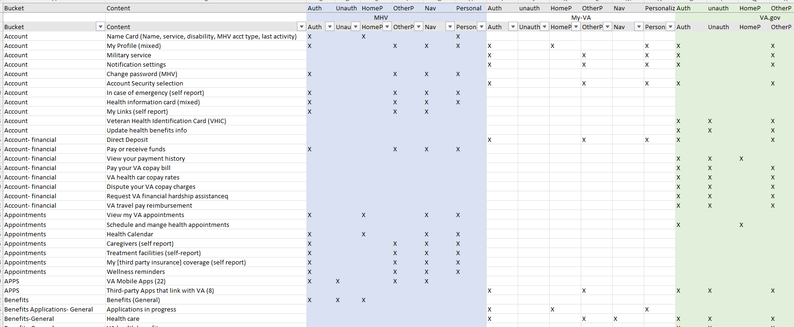
POC Design: Review MyVA.gov and prep for OCTO
CLIN 0001AB
Deliverable: Captured learnings and impacts in POC Design PPT
Cross site analysis of all health-things content
Analysis of Va.gov, MHV, and MyVA sites
Strengths and weakness in current POC path
Questions developed for OCTO meeting prep
Identify health-things or general content being built by other teams
Identify health-things content intended for VFS-APT
For content not being considered for VFS-APT or other teams, where will it be homed
Meet team PM’s and PO’s working on crossing content
(updated 12.23.21)

Slide 53
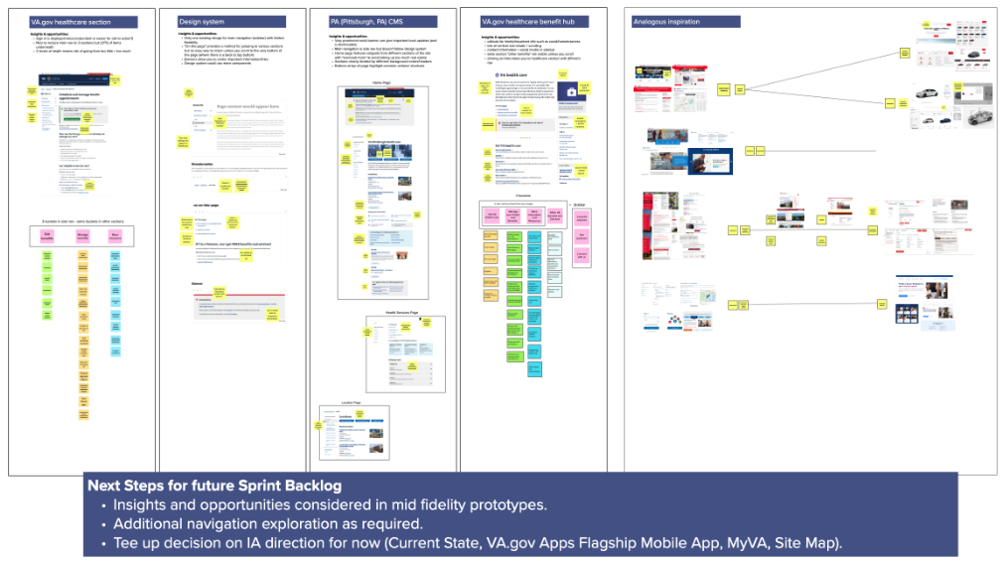
POC Design: Synthesize navigation system research
CLIN 0001AB
Deliverable: Captured learnings / impacts in POC Design PPT including impacts on homepage and considerations for Health Apartment POC Design features to be designed in future sprints
Synthesized research into navigation system and uncovered insights, design opportunities, and impacts on Health Apartment POC Design (e.g., homepage and landing pages for auth and not auth key features)
Please refer to IA Design chapter in PPT

Slide 54
POC Design: Define VFS-APT POC acceptance criteria
CLIN 0001AB
Deliverable: Updates to POC Design PPT
Reviewed and synthesized various research reports and conversations notes to consolidate priorities, effort levels, and capabilities
Developed proposed POC features for feedback / alignment
Conducted meeting with Ryan Thurwell per Lauren’s guidance
Proposed POC features:
Homepage
Appointments (scheduling)
Messaging

Slide 55
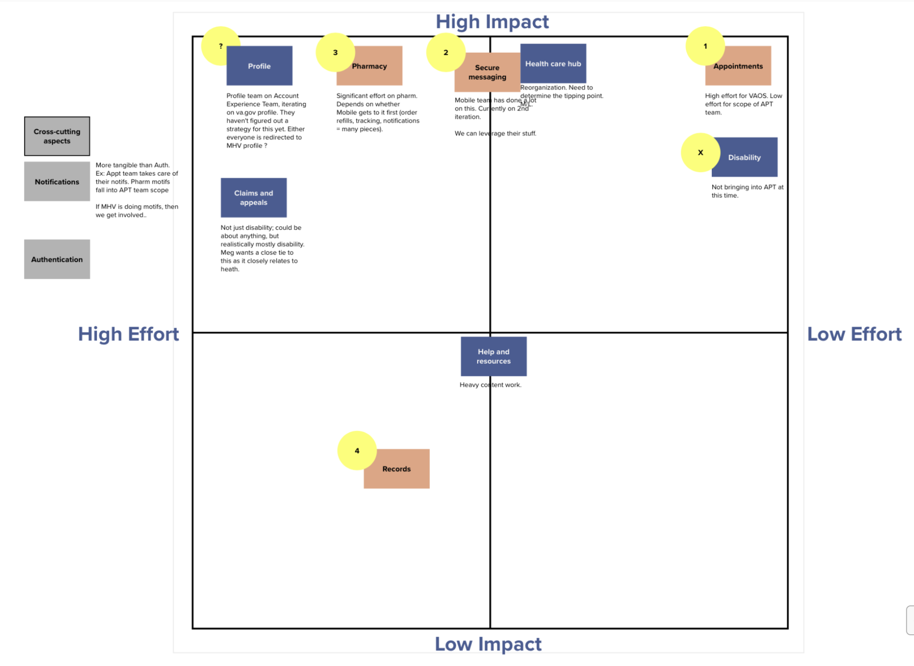
POC Design: Define VFS-APT POC acceptance criteria
CLIN 0001AB
Next Steps
Finalize POC feature acceptance with VA PO, Design Lead and Executive Sponsor
Remaining questions
Where and when is the handoff between Apartment and VAOS?
What is our direction on navigation?

Slide 56
POC Design: VA.gov exploration
CLIN 0001AB
Deliverable:
Captured learnings and impacts in POC Design PPT
Incorporated VA.gov user research / testing processes, methods, and tool into POC Design PPT and Product Roadmap
VA.gov research process:
Plan
Recruit
Run pilot
Conduct
Synthesize
Share
(updated 12.22.21)

Slide 57
Collaboration Cycle: Design intent
CLIN 0001AB
Deliverable: Updates to POC design PPT
Scheduled and conducted meeting with Ryan Thurlwell 11/29
Reviewed work to date with positive comments on mid fidelity wireframes for auth / unauth home pages
Insights
Landscape of My VA , Mobile, and notification functions remain undetermined and final decisions could affect homepage design content decisions
Emphasized that we focus on deeper levels then return to homepage when higher level collaborative decisions are finalized
Test design schemes using adaptability settings (specifically 400% zoom and how items should shake out)
Use economy of word choice to save space
Think through notification scheme (all v. focus for content page)
Next steps
Continue with Sprint 6 plan to test iterate, retest current homepage designs to settle into preferred design plan for MVP
Evaluate current and developing wireframe designs for cursory adaptability
Brainstorm notification needs for work product.
Convene meeting with Ryan Thurlwell (USDS DEPO design Lead), VA-PO, product owner, and development team to discuss current product and collaboration timeline with other teams.

Slide 58
End of Sprint 5 Update
CLIN 0001AB
The team’s accomplishments this sprint include:
IA Tree Test synthesis
Synthesized IA tree test results; identified HMW opportunities for design 11/18
Shared mural with design team 11/18 for inclusion in potential concepts 11/19
Tightened IA on sitemap 11/22
Homepage wireframe concepts to mid fidelity
Secured access and training on Sketch for development team 11/17
Developed multiple low-fi prototype concepts for consideration 11/18
Aligned and selected top 3 prototype design concepts to develop to mid-fi 11/19
Developed mid-fi wireframes for concept 1 11/22
Developed mid-fi wireframe and navigation considerations concept 2 11/23
Evolved mid-fi wireframes concept A w/ navigation, and developed concept 3 with navigation considerations 11/24
Completed mid-fi wireframes for concept 3 and completed PPT 11/29
MyVA.gov research and OCTO engagement prep
Initiated research into MyVA 11/24
Synthesized research (impacts / overlaps) 11/29
Navigation research synthesis
Conducted navigation review of MHV and included in conceptual wireframes 11/22
Conducted deepdive into previous user tests and concepts for earliest work on MHV for potential insights / inclusion with current POC 11/24
Finalized research report into mural and PPT items 11/29
Health Apartment POC Acceptance Criteria
Conducted meeting with VA PO to discuss wavetops of POC Acceptance criteria 11/23
Reviewed and synthesized various research reports and conversations notes to consolidate priorities, effort levels, and capabilities 11/26
Developed proposed POC features for feedback / alignment 11/29
Conducted meeting with Ryan Thurwell per Lauren’s guidance 11/29
VA.gov exploration
Implemented VA.gov research methodology and result synthesis into IA tree test 11/23
Collaboration cycle, design intent
Researched collaboration cycle requirements 11/18
Conducted meeting with Shira from VA Platform Support (collab kickoff delayed for MVP)
Researched checkpoint criteria and created phased checklist x 2 11/19
Messaged Ryan Thurlwell 11/22; OOO for holiday rtn 11/29
Created additional checkpoint criteria checklist x1 11/23
Conducted introductory meeting with Ryan Thurlwell and captured insights and next steps for consideration in future sprints 11/29

Slide 59
Sprint 5 Acceptance
CLIN 0001AB
Sprint Dates: 11/17/2021-11/30/2021
Sprint Goals: Make progress toward Health Apartment POC through evolving sitemap and initial mid fidelity homepage concepts with navigation implications and design consideration from IA tree test, VA.gov / MyVA.gov research. Consolidate research and questions for MyVA.gov OCTO engagement. Align on VA product checkpoint / tollgate expectations and health apartment POC acceptance criteria.
Focused Epics (Approval)
POC Design: IA Tree Test synthesis
POC Design: Homepage wireframe concepts to mid fidelity
POC Design: MyVA.gov research and OCTO engagement prep
POC Design: Navigation research synthesis
POC Design: Health Apartment POC acceptance Criteria
POC Design: VA.gov exploration
Collaboration cycle: Design intent
Focused Epics (Acceptance)
√ POC Design: IA Tree Test synthesis
√ POC Design: Homepage wireframe concepts to mid fidelity
√ POC Design: MyVA.gov research and OCTO engagement prep (accepted by VA-PO 12/23)
√ POC Design: Navigation research synthesis
√ POC Design: Health Apartment POC acceptance Criteria (accepted by VA-PO 12/21)
√ POC Design: VA.gov exploration and integration options (accepted by VA-PO 12/22)
√ Collaboration Cycle: Design intent Stakeholder engagement: USDS Design Lead
Deliverables: Name / Description | Acceptance Criteria
POC Design PPT | √ Synthesized, captured, annotated IA tree test results and impacts on components / features for wireframe development √ Identified impacts and overlaps of MyVA product on POC design √ Defined objectives, questions, and activities to guide future interaction with myVA team √ Captured VA.gov research, process, methods, tools, and feedback / changes for POC design √ Synthesized navigation system research with insights, design opportunities, and impacts on POC design features √ Captured design insights and next steps Ryan Thurlwell USDS DEPO Design Lead
Homepage concepts (mid-fidelity) Sketch | √ User feedback from IA tree test incorporated into 3 Sketch homepage wireframe concepts (auth/non-auth, mobile/desktop) √ Annotated in mural impacts on components / features for deeper level wireframes for consideration in future sprints √ Synthesized navigation system research into mid level fidelity wireframes; identifying breaks √ Identified navigation points where system will be broken
Evolved sitemap mural | √ Updated sitemap (v4) to include insights from IA tree test synthesis
VA-PO engagement | √ Invited VA-PO & VA design lead to 3 design discussions per sprint √ Invited VA-PO to PM synch twice a week √ Captured feedback and requested changes for design consideration in current and future sprints √ Defined & confirmed acceptance criteria for health apartment POC design and incorporated into roadmap

Slide 60
Show me, don’t tell me: Sprint 6 Demo
14 December 2021
Contract #: 36C10B21D0007
Order #: 36C10B21N00070001

Slide 61
Sprint 6 Approval (1 of 2)
CLIN 0001AB
Sprint Dates: 12/1/2021-12/14/2021
Sprint Goal: The goal of this sprint is to narrow in on final homepage design through rapid test-and-iteration cycles, coupled with collaboration sessions between MO and our VA partners for presentation to VA stakeholders at apartment working group. Develop agenda and presentation for January AWG. Develop research plan for moderated study in following sprint. Refine product roadmap to include tactical and lifecycle elements, tollgates, and delivery estimates.
Priority | Epic: User Story | Acceptance Criteria
High | Testing and iterating: Implement VA feedback | Iterated homepage designs based on feedback from VA-PO, VA-Design Lead and VA Executive Sponsor Documented iteration in Mural Deliverable: Research plan and report Deliverable: Evolved design mural
High | Testing and iterating: Write research plan | Developed research plan for guerrilla user testing, including questions and methods Developed research plan for formal testing using VA methods and contract for Sprint 7 Uploaded research plans to GitHub repo Deliverable: Research plans and report
High | Testing and iterating: Recruit research participants | Recruited a diverse set of research participants (n=10-50) for Guerrilla testing Recorded participant demographics in research plan Deliverable: Research plan and report
High | Testing and iterating: Testing | Tested users according to research plan Conducted multiple rounds of user research / testing based on evolved design iterations Deliverable: Research plan and report
High | Testing and iterating: Synthesize research findings | Shared research findings with VA-PO and VA-DL at design meetings Reported summary of findings in research report in GitHub repo Deliverable: Research plan and report
Updated 12.3.2021 w/ additional VA-PO input

Slide 62
Sprint 6 Approval (2 of 2)
CLIN 0001AB
Priority | Epic: User Story | Acceptance Criteria
High | Testing and iterate: Iterate homepage designs | Iterate designs multiple times based on research findings and feedback from stakeholders Documented iteration in Mural Deliverable: Evolved design mural
High | Testing and iterate: Downselect design elements | Held consensus-gathering meetings with VA-PO to decide on final homepage design and sitemap Deliverable: Evolved design mural
High | Apartment Working Group: AWG meeting prep | Created deck and mural to reflect relevant work leading up to current design decisions Created agenda for distribution to VA executives and stakeholders (by VA-PO) Deliverable: AWG deck Deliverable: AWG agenda
High | PMO: ZenHub migration | Migrated stories, epics and initiatives to ZenHub ZenHub read and write access granted to all MO team members Deliverable: N/A
High | POC Design: Project roadmap | Project Roadmap revised with tactical and lifecycle elements, tollgates, and delivery estimates Multiple meetings with VA-PO to project roadmap deliverable dates and expectations Deliverable: Revised Product Roadmap
Updated 12.3.2021 w/ additional VA-PO input

Slide 63
POC Design: Project roadmap
CLIN 0001AB
Deliverable: Revised product roadmap
(living document)
PoC Definition
Collaboration session with VA-PO to agree upon agenda and content for meeting
Aligned on goal of meeting and presentation style
Developed deck to represent agenda items with links to proof-of-concept timeline and iterative work of homepage designs
PoC Roadmap
Project roadmap established in ZenHub
Roadmap socialized with VA-PO and feedback implemented
Roadmap socialized with development team
Sprint backlog migrated into ZenHub
ZenHub access established for all VFS-APT team members
Notes:
paula 5-7

Slide 64

Apartment working group: AWG meeting prep
CLIN 0001AB
Deliverable:
AWG presentation deck
AWG agenda
Preparation
Collaboration session with VA-PO to agree upon agenda and content for meeting
Aligned on goal of meeting and presentation style
Developed deck to represent agenda items with links to proof-of-concept timeline and iterative work of homepage designs
Notes:
paula 5-7

Slide 65
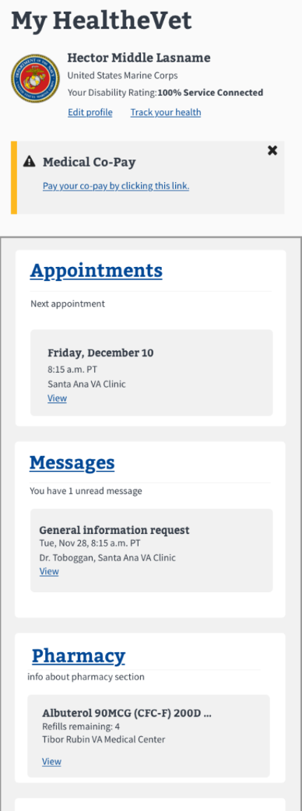
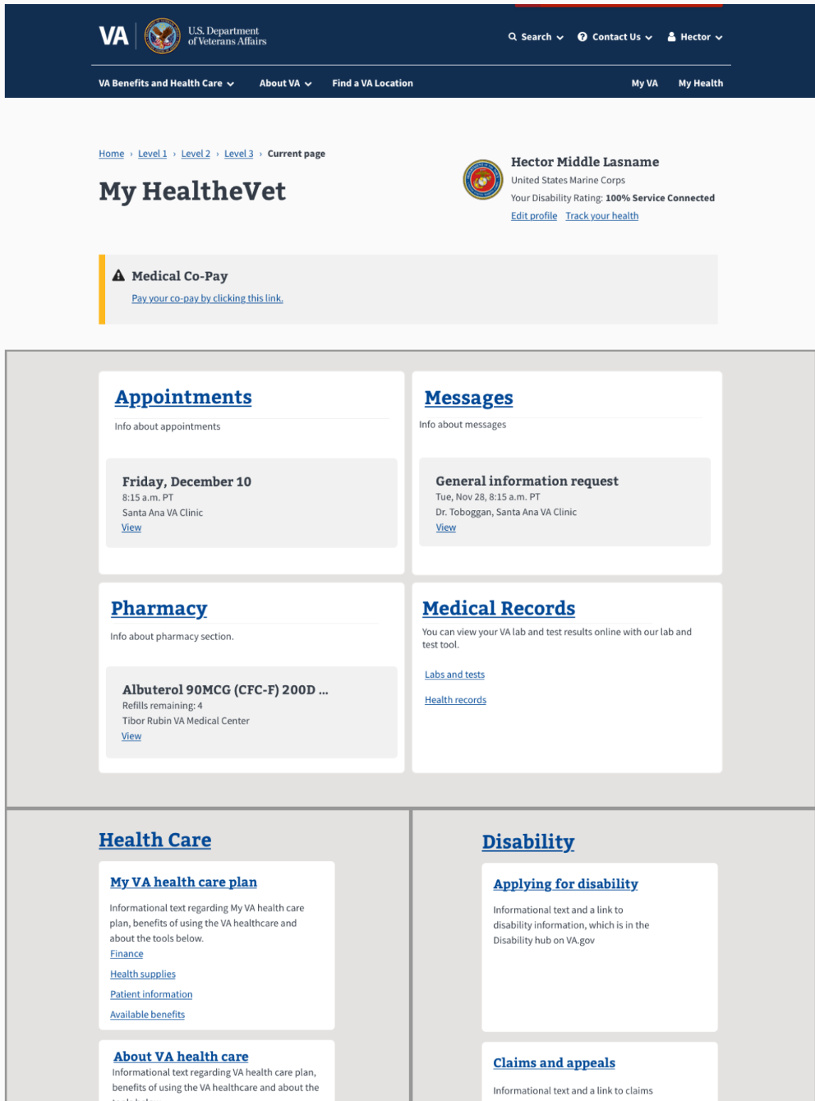
Research plan and report
CLIN 0001AB
Deliverable:
Guerrilla Research plan and report
Draft formalized research plan
Guerrilla testing
Guerrilla research plan here
Conversation guide here
Consent form here
Research report here
Homepage desktop authorized version for test
Homepage mobile authorized version for test
Key Findings:
All participants wanted more specific actions in the "Big Four" cards
Most (4) participants expected some sort form of personalization
All participants gave a different answer for what they expected in "Messages"
Most (4) participants wanted more resources and definition in the "Non-VA Provider" section
Notes:
paula 5-7

Slide 66
End of Sprint 6 Update
CLIN 0001AB
The team’s accomplishments this sprint include:
Stakeholder engagement
Design meeting held VA-PO VA-DL 12/2, 12/7, 12/9
Design office hours held 12/8-12/10 for VA stakeholder input
MO-PO and VA-PO weekly project review 12/2, 12/9
Research plan
Initial draft of guerrilla research plan submitted for review by VA-PO VA-DL 12/3
Revision iterations with VA research lead for guerilla testing 12/6-12/10
Final guerrilla research proposal submitted for approval 12/10
Draft version of formalized testing for sprint 7 socialized with VA research lead 12/8
Recruiting
Solicited close contact veterans for guerrilla testing subjects 12/2, 12/3
Subject minimal demographics entered in research plan 12/9
Consent forms sent to research participants 12/10
Testing and synthesis
Testing of initial respondents 12/13-12/14
Results of guerrilla study synthesized and entered into research report 12/14
Dev design team provided research synthesis for consideration in next iteration of homepage designs 12/14
Design iteration
Iterated sitemap and homepage designs w/ VA-PO and VA Design Lead input 12/3
Iterated homepage from VA stakeholders 12/6-12/10
Apartment working group
Meeting with VA-PO regarding agenda and flow of AWG slides 12/8
AWG slides iterated to reflect feedback from VA-PO and VA-DL
AWG deck and agenda loaded into GitHub repository 12/14
ZenHub migration
ZenHub training for product manager and CSM 12/6
Epic Population of ZenHub 12/6
User stories for sprint 6 migrated 12/9
Revised product roadmap
Met w/ VA-PO to discuss Roadmap expectations 12/2
Roadmap entered into ZenHub
Roadmap reviewed by VA-PO 12/13
VA Cedar / platform / project onboarding
Content strategist completed VA CEDAR and project onboarding 12/10/21
All new staff (4) completed mandatory 1hr VA platform orientation on 12/7
All new staff (4) assigned platform support checklist in GitHub for next sprint 12/10

Slide 67
Sprint 6 Acceptance
CLIN 0001AB
Sprint Dates: 12/1/2021-12/14/2021
Sprint Goal: The goal of this sprint is to narrow in on final homepage design through rapid test-and-iteration cycles, coupled with collaboration sessions between MO and our VA partners for presentation to VA stakeholders at apartment working group. Develop agenda and presentation for January AWG. Develop research plan for moderated study in following sprint. Refine product roadmap to include tactical and lifecycle elements, tollgates, and delivery estimates.
Focused Epics (Approval)
Testing and iterating: Implement VA feedback
Testing and iterating: Write research plan
Testing and iterating: Recruit research participants
Testing and iterating: Testing
Testing and iterating: Synthesize research findings
Testing and iterating: Iterate homepage designs
Testing and iterating: Down select design elements
Apartment working group: AWG meeting prep
PMO: ZenHub migration
POC Design: Project roadmap
Focused Epics (Acceptance)
√ Testing and iterating: Implement VA feedback
√ Testing and iterating: Write research plan
√ Testing and iterating: Recruit research participants
√ Testing and iterating: Testing
√ Testing and iterating: Synthesize research findings
√ Testing and iterating: Iterate homepage designs
X Testing and iterating: Down select design elements deferred
√ Apartment working group: AWG meeting prep
√ PMO: ZenHub migration
√ POC Design: Project roadmap
Deliverables Name / Description | Acceptance Criteria
Revised product roadmap | √ Created revised product roadmap w/ VA-PO input to include tactical and product life-cycle events
AWG agenda and presentation deck | √ Created AWG agenda and presentation deck with VA-PO input
Evolved homepage design mural | √ Evolved POC designs by including research insights, input from VA-PO / VA Design Lead and other VA stakeholders, into a singular product for moderated study in following sprint
Research plan and report | √ Created research plan, recruited participants, conducted testing and synthesized results for POC design test-iterate-test into report with guidance and assistance from VA Design Lead (post-test iteration cycle deferred).
Draft research plan for Sprint 7 | √ Developed draft research plan for formalized study for VA research lead review and application in following sprint

Slide 68
Show me, don’t tell me: Sprint 7 Demo
28 December 2021
Contract #: 36C10B21D0007
Order #: 36C10B21N00070001

Slide 69
Sprint 7 Approval (1 of 2)
CLIN 0001AB
Sprint Dates: 12/15/2021-12/28/2021
Sprint Goal: Evolve homepage designs into low level of fidelity using selected recommendations by VA-PO / VA-DL from Guerrilla user testing in sprint 6 and other VA stakeholder input. Finalize approved conversation guide and research plan for a round of formalized user testing with Perigean. Engage in collaboration cycle discussions and preparation through updating and presenting product brief for the MyHealtheVet health apartment and design interactions during discussions with platform support to determine collaboration cycle approach plan: design intent. Complete onboarding of new team members through platform and historical project learning tools, SME meetings, and tool access / training.
Priority | Epic: User Story | Acceptance Criteria
TBD | Test and iterate: Synthesize research findings | Reviewed research report from Sprint 6 guerrilla testing and developed list of recommendations Presented a list of recommendations to VA-PO, VA-DL, and other interested VA stakeholders for review / approval / prioritization Deliverable: N/A
TBD | Test and iterate: Iterate homepage designs | Iterated homepage designs based on approved recommendations from VA-PO, VA-DL, and other interested VA stakeholders Reduced designs to low level fidelity, where able* Deliverable: Iterated homepage designs, low level of fidelity
TBD | Program: Health apartment / Project onboarding | Completed VA platform orientation checklist; content and design : Carl Completed VA platform orientation checklist; designer: Jesse Completed VA platform orientation checklist; project Management (modified): Tami Completed VA platform orientation checklist; project management (full): Jordan Deliverable: Completed orientation checklists: VA platform orientation
TBD | Program: Health apartment / project onboarding | Completed Historic health apartment project onboarding: Carl Completed Historic health apartment project onboarding: Jesse Completed Historic health apartment project onboarding: Tami Completed historic health apartment project onboarding: Jordan Deliverable: Completed orientation checklists: Historic health apartment
TBD | Collaboration Cycle | Discussed current stage of design iteration and readiness / requirements to enter collaboration cycle: design intent Socialized readiness / requirement status with VA-PO and VA-DL Deliverable: N/A
* Sketch does not contain a robust cache of low fidelity design tools for mobile. UX lead has reached out on design slack for solutions.
** Federal winter holiday and leave season may limit / delay work where VA input or approval is key. Every attempt will be made to front end workload.

Slide 70
Sprint 7 Approval (2 of 2)
CLIN 0001AB
Priority | Epic: User Story | Acceptance Criteria
TBD | Collaboration cycle | Reviewed product brief for the MyHealtheVet health apartment in GitHub Updated document to reflect current team and changes to design intent Socialized with VA-PO and VA-DL for review / edits / approval Deliverable: Evolved product brief for the MyHealtheVet health apartment
TBD | Test and iterate: Conversation guide | Drafted conversation guide for formal user testing of homepage designs Socialized conversation guide with VA-PO, VA-DL, and VA researcher for review / edits / approval Deliverable: Approved formalized research conversation guide
TBD | Test and iterate: Research plan | Revised research plan for formalized user testing of homepage designs Socialized research plan with VA-PO, VA-DL, and VA researcher for review / edits / approval Deliverable: Approved formalized research plan
TBD | Test and Iterate: Iterate stakeholder input homepage designs | Socialized iterated designs at scheduled design meetings and design office hours for VA stakeholder input Evaluated and iterated or down-selected design suggestions Provided feedback on all down-selected design suggestions to VA-PO / VA-DL Iterated any design suggestions previously down-selected, if recommended by VA-PO Deliverable: Iterated homepage designs
TBD | Test and iterate: Iterate content / copy edits homepage designs | Reviewed all iterative designs for content / copy edits Socialized all major content / copy edits with VA-PO and VA-DL during scheduled design meetings and design office hours for review / approval Deliverable: Iterated homepage design
TBD | Collaboration cycle | Populated design meeting deck based on VA templates with results from guerrilla research Socialized design meeting deck with VA-PO and VA-DL for review / edits / approval Deliverable: Design deck for presentation at 12/20 design meeting

Slide 71
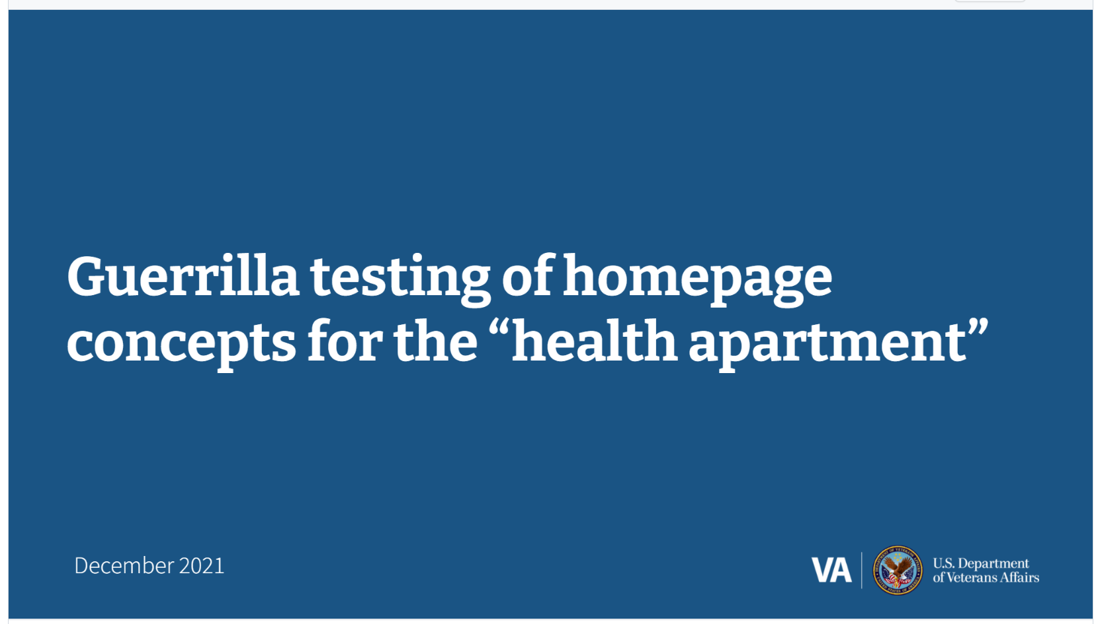
Collaboration cycle: Design meeting deck and presentation
CLIN 0001AB
Deliverable: Presentation deck for 12/20 design meeting
Notes:
paula 5-7

Slide 72
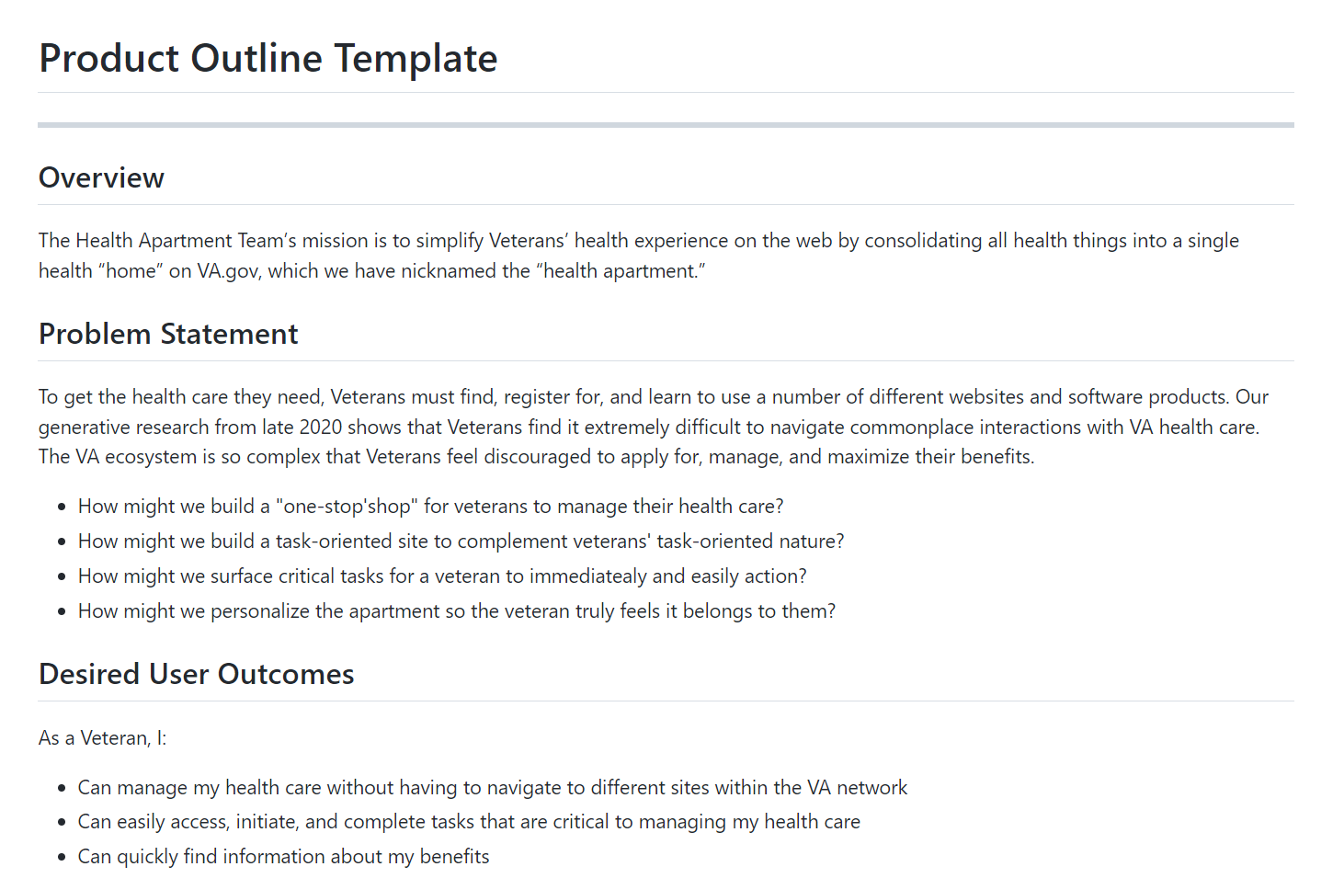
Collaboration cycle: Update product brief
CLIN 0001AB
Deliverable: Evolved product brief for the MyHealtheVet health apartment
Notes:
paula 5-7

Slide 73
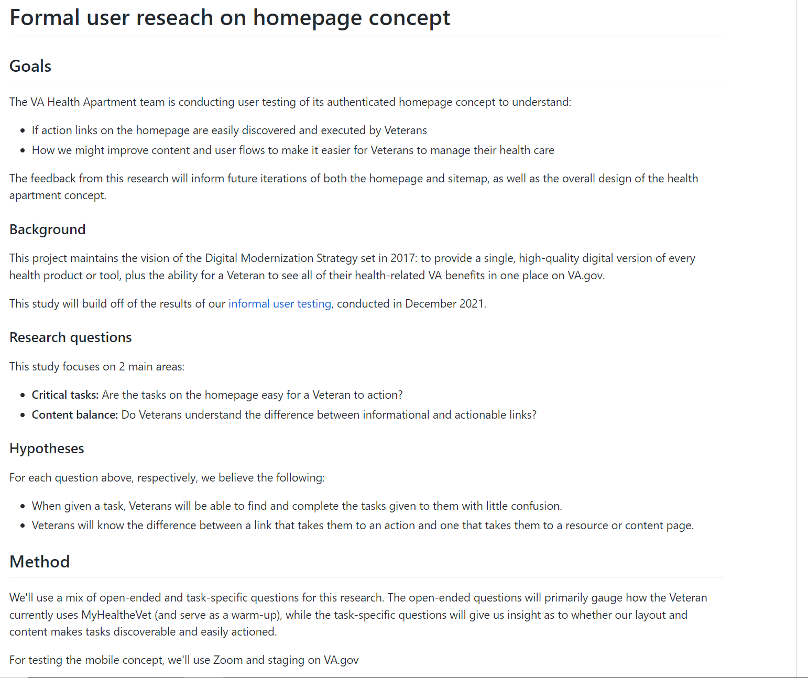
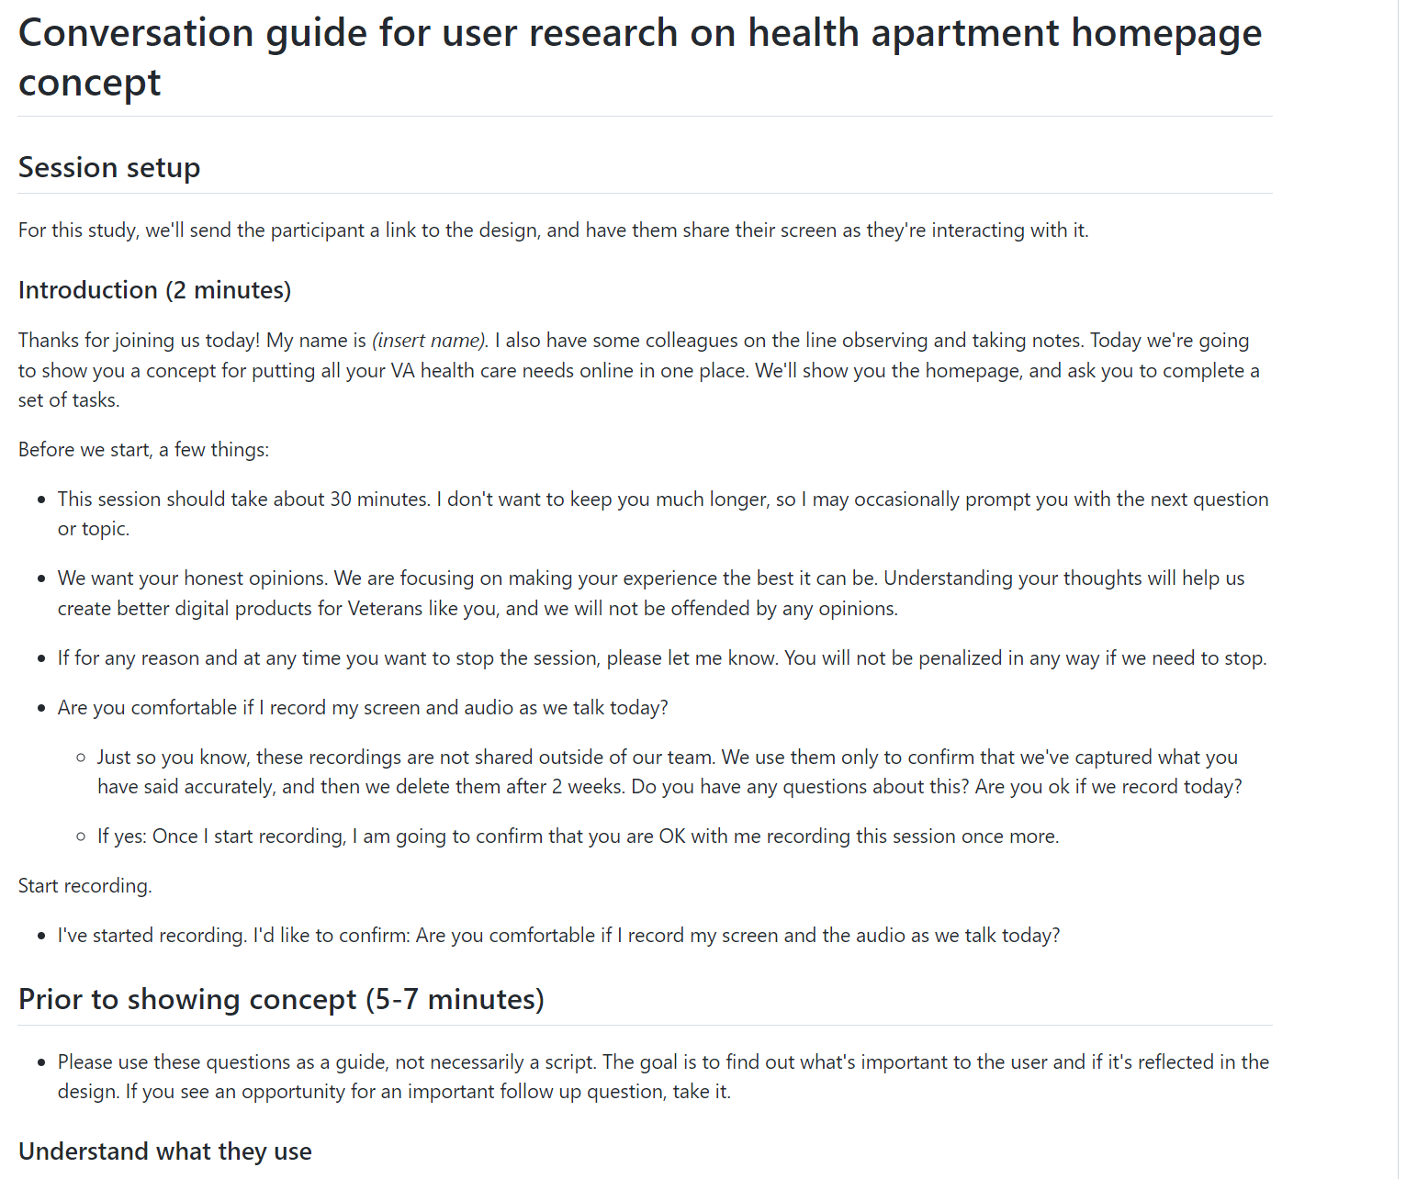
T&I: Formal research plan and conversation guide
CLIN 0001AB
Deliverable: Formal research plan
Deliverable: Conversation guide
Notes:
paula 5-7

Slide 74
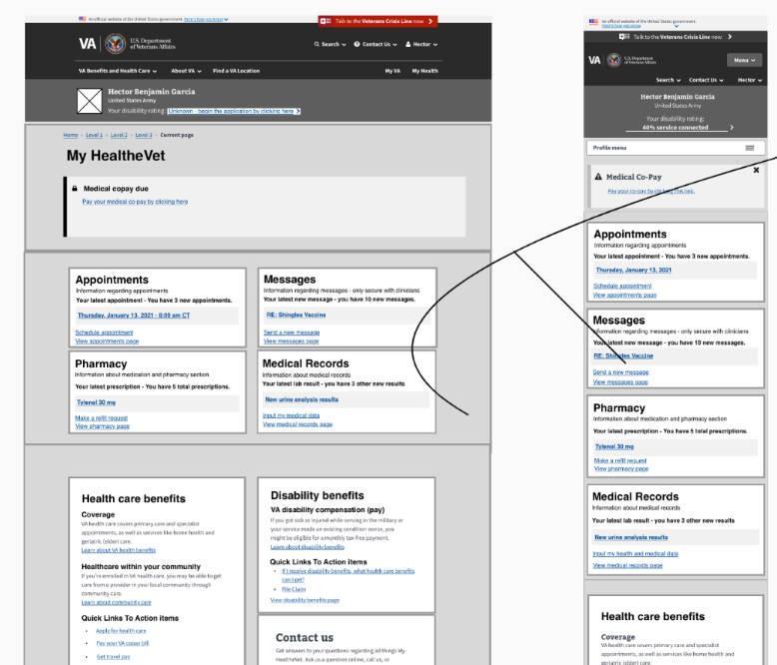
T&I: Iterated homepage designs (sprint 6 recommendations, content and copy, stakeholder input)
CLIN 0001AB
Deliverable: Iterated homepage designs
Notes:
paula 5-7

Slide 75
End of Sprint 7 Update
CLIN 0001AB
The team’s accomplishments this sprint include:
Guerrilla user testing recommendations
Completed recommendations list for prioritization / down select 12/15
Completed transition to low level of fidelity for homepage designs 12/16
Discussed recommendations w/ VA-PO VA-DL for design item selection 12/17
Iterated recommendations into homepage designs 12/18
Homepage iteration
Low level of fidelity 12/16, recommendations from sprint 6 research 12/18
Copy and content made for homepage iterations 12/16-12/20
Design open office with acceptance criteria defined from VA-PO 12/23
Research on design elements from prior generative research conducted 12/23-12/26
Designs integrated with acceptance criteria 12/27
Team design review for demo 12/27
Collaboration cycle approach plan
Organized meeting with VA-PO and VA platform support to discuss 12/16
Draft of design deck for 12/20 design meeting 12/16
Held meeting with platform support 12/17
Presented HLT-APT PoC designs-homepage to Design, Research, and Content group 12/20
Product brief for the MyHealtheVet health apartment
Brief expectations discussed with VA-PO 12/20
Draft brief provided to VA-PO for review 12/21
Additional information provided regarding MyVA for consideration 12/22
User research conversation guide
Draft of conversation guide completed 12/20
Draft provided to VA-PO for review for iteration 12/21
Reexamined discussion guide for relevancy with updated designs 12/27
Research plan (Perigean)
Research plan drafted 12/17-12/20
Draft provided to VA-PO for review and iteration 12/21
Additional iterations 12/21-12/23
Accepted by VA-PO, forwarded to other stakeholder review for edits 12/23
Platform and product onboarding
Historic product onboarding- Carl 12/17, Jordan 12/17, Tami 12/27, Jesse 12/20
Platform support onboarding- Jesse 12/17, Tami 12/18, Carl 12/17, Jordan 12/27
Stakeholder engagement
Design Review 12/21, 12/23
VA-PO Sync 12/16, 12/23
HLT-APT homepage POC presentation 12/20/21
Design open office 12/17, 12/20, 12/21, 12/22, 12.23

Slide 76
Sprint 7 Acceptance
CLIN 0001AB
Sprint Dates: 12/15/2021-12/28/2021
Sprint Goal: Evolve homepage designs into low level of fidelity using selected recommendations by VA-PO / VA-DL from Guerrilla user testing in sprint 6 and other VA stakeholder input. Finalize approved conversation guide and research plan for a round of formalized user testing with Perigean. Engage in collaboration cycle discussions and preparation through updating and presenting product brief for the MyHealtheVet health apartment and design interactions during discussions with platform support to determine collaboration cycle approach plan: design intent. Complete onboarding of new team members through platform and historical project learning tools, SME meetings, and tool access / training.
Focused Epics (Approval)
Collaboration cycle: Update product brief
Collaboration cycle: Design meeting deck and presentation
Collaboration cycle: Collaboration cycle approach plan
Test and iterate: Synthesize and prioritize research findings sprint 6
Test and iterate: Iterate prioritized items from sprint 6 and downgrade to low-fidelity
Test and iterate: Research plan
Test and iterate: Conversation guide
Test and iterate: Stakeholder input on homepage designs
Test and iterate: Content and copy edits to homepage designs
Program: Historic project onboarding (4)
Program: VA Platform onboarding (4)
Focused Epics (Approval)
√ Collaboration cycle: Updated product brief
√ Collaboration cycle: Designed meeting desk and presentation
√ Collaboration cycle: Collaboration cycle approach planned
√ Test and iterate: Synthesized and prioritized research findings sprint 6
√ Test and iterate: Iterated prioritized items from sprint 6 and downgraded to low-fidelity
√ Test and iterate: Research plan developed
√ Test and iterate: Conversation guide developed
√ Test and iterate: Stakeholder input iterated on homepage designs
√ Test and iterate: Content and copy edits iterated on homepage designs
√ Program: Historic project onboarding (4) ZenHub
√ Program: VA Platform onboarding (4)
Deliverables Name / Description | Acceptance Criteria
Evolved MyHealtheVet health apartment product brief | √ Approved and updated product brief that reflects current team and changes to design intent
Iterated homepage designs, low level of fidelity | √ Iterated approved recommendations from Sprint 6 Guerrilla testing to low-level of fidelity homepage designs √ Iterated content and copy edit √ Iterated homepage designs based on stakeholder feedback during open design sessions
Approved research plan and conversation guide | √ VA-PO approved research plan and conversation guide for formal user testing of homepage designs
Completed orientation checklists (8) in ZenHub | √ Completed historic program and platform support onboarding checklists in ZenHub (8)
Design deck for 12/20 design meeting | √ Approved design meeting deck on VA templates with results from guerrilla research

Slide 77
Show me, don’t tell me: Project Risks

Slide 78

Project Risks and Mitigation Strategies
Serious risk
CLIN 0001AB
Some risks / delays
Everything is good
Risk and Impact | Mitigation Strategy | Date |  | Status | Notes
 |  | Entered | Closed
Laying a foundation of trust between MyHealtheVet and VA.gov teams. | Respect the collaboration gains and create meaningful moments to engage as a team. | 10/7/21 |  |  | Just starting liaison meetings with MyVA
Operating in an environment with multiple stakeholders and many layers of support. | Create and maintain dynamic stakeholder matrix and RACI. | 10/7/21 |  |  | Players unknown, still working on relationship building
Ramping the team after Kickoff may impact team norming. | Be super engaged and proactive with Champion at SteerCo meetings. | 10/7/21
Confusing Veterans regarding location of MyHealtheVet functionality while consolidating to MyVA | Stay in front of VSOs and TAP sources to impact habit patterns and collect secondary feedback. | 10/7/21
Reconciling the two different Terms of Service (ToS) across My HealtheVet and VA.gov. | Work to consolidate ToS early to prevent Health Apartment from being blocked. | 10/7/21
Operating in an environment with multiple stakeholders with many layers of influence and integration can lead to misaligned goals and competing priorities. | Develop a deliberate and persistent omnichannel approach to stakeholder engagement. Improved understanding with stakeholder session with Lauren on 9/20. | 10/7/21
Onboarding the landing team, building in governance, recruiting and staffing open roles, and building the backlog and roadmap could lead to misaligned expectations across work streams. Misaligned expectations on deliverables. | Communicate frequently and transparently. Align on the definition of done. | 10/7/21
There are a lot of unknowns around the technical aspect of the PoC. Technical roadblocks could cause delays later in the program. | Build in time for technical discovery and research to identify the technical dependencies and highlight gaps that need to be addressed. | 10/7/21
Potential for government shutdown. Loss of access to VA team could lead to uncertainty on priorities, limited ability to remove blockers, and other delays. | Planned for work that could be done independently, but shutdown did not occur. | 9/30/21 11/3/21

Slide 79
Project Risks and Mitigation Strategies
Serious risk
CLIN 0001AB
Some risks / delays
Everything is good
Risk and Impact | Mitigation Strategy | Date |  | Status | Notes
 |  | Entered | Closed
Aryea & Emily from OCTO and Lara from MO Studio rolled off the program. Loss of team capacity, design expertise, product oversight, and continuity. | Prioritized knowledge transfer, introductions, and working sessions before their official roll off. Jeff stepped in to guide as interim Program and Product Manager. | 11/1/21 | 11/30/21 |  | Dedicated PM & PO onboard.
Identify clear PIV process owner from VA Team. Dedicated Security Officer (Kemi) support ended mid Sept; dedicated Security Officer assistance not available to date. PIV forms loaded to VA Secure SharePoint site on 10/25. Four (4) people pending e-QIP initiation. Gap in process likely delay contract compliance and access to systems. | 11/1 MO Studio built an end-to-end PIV checklist based on other VA project work. WIll request ad hoc support from Kemi to validate steps. Identify clear PIV process owner from VA Team. Dedicated Security Officer (Kemi) support ended mid Sept; dedicated Security Officer assistance not available to date. | 11/1/21
Recruiting, hiring, and onboarding candidates impacted not only by the tight labor market (i.e., "Great Resignation") but also the lack of clarity on Product Strategy and needed capabilities / skill sets on the team to deliver on expansive scope. Delivery teams pick up the workload as time to fill roles is extended. | Building a strong brand across multiple platforms including Slack channels, job forums, recruiting tools, networking groups, and OCTO Ecosystem. Created dashboard to provide transparency into open roles. Built talent pool and engaging past and passive candidates. Aligned with Product Owner on design competencies needed on core team and prioritized focus / JD’s. Utilized automation tools within our recruiting software to optimize the recruiting process and write engaging and relevant job descriptions. | 11/2/21 |  |  | 5 individuals have been onboarded to the team as of 12/1. Recruiting is still actively ongoing.
Approaching holiday season will reduce the number of available Gov’t stakeholders for collaborative work. Decreased accessibility to key Gov’t contacts. | Will build robust backlog of independent work as a part of our roadmap per CEDAR TO1. | 11/3/21 |  |  | Team to get advance visibility into government stakeholder OOO and will continued account for decreased touchpoints in sprint planning.

Slide 80
VA CEDAR IDIQ TO1
VETERAN-FACING SERVICES – DIGITAL HEALTH MODERNIZATION
Compliance, Governance and Reporting
CLIN 0001AA: Delivery Report
CLIN 0001AB: Monitoring Report
CLIN 0001AC: Contractor’s Progress, Status and Management Report
CLIN 0001AD: Status of Government Furnished Equipment Report
CLIN 0001AE: Personnel Contractor Manpower Report
CLIN 0001AF: Contractor Staff Roster

Slide 81
Contractor’s Progress, Status and Management Report
CLIN 0001AC
The Contractor shall submit a Quarterly Status Report in accordance with the Base PWS 9.2.1.
Roadmap
Scope / Bounds
High Level Risks / Mitigation Strategies
Deliverable Tracker
Sprint Approval Process
Sprint Approval Tracker

Slide 82
Roadmap and Progress
CLIN 0001AC
Today
PHASE
Plan
Intend
SPRINT
0
1
2
3
4
5
6
7
8
9
10
11
12
13
14
15
16
MONTH
September
October
November
December
January
February
March
April
EPIC
Landing Team and Kickoff
Recruiting, Hiring, and Onboarding
Research & Discovery
PoC
Build & Test (MVP)
Checkpoints
Collaboration Cycle

Slide 83
Monthly Calendar - October 2021
CLIN 0001AC
Monday | Tuesday | Wednesday | Thursday | Friday
10/4 | 10/5 Sprint 1 Demo: 11am ET Sprint 1 Retro: 2pm ET | 10/6 Sprint 2 Kickoff: 10am ET | 10/7 | 10/8
10/11 | 10/12 | 10/13 Backlog Grooming: 2pm ET | 10/14 Sprint 3 Planning: 11am ET | 10/15
10/18 Sprint 2 Demo: 11am ET Sprint 2 Retro: 12pm ET | 10/19 POC and MVP Check-in: 9am ET | 10/20 Sprint 3 Kickoff: 10am ET | 10/21 | 10/22
10/25 | 10/26 POC and MVP Check-in: 9am ET | 10/27 Apartment Working Group: 2pm ET Backlog Grooming: 4pm ET | 10/28 Sprint 4 Planning: 11am ET | 10/29
SPRINT 1
SPRINT 2
SPRINT 2
SPRINT 2
SPRINT 3
SPRINT 3

Slide 84
Monthly Calendar - November 2021
CLIN 0001AC
Monday | Tuesday | Wednesday | Thursday | Friday
11/1 Pre Demo Prep: 4pm ET | 11/2 POC and MVP Check-in: 9am ET Sprint 4 Demo & Retro: 11am ET | 11/3 Admin Day | 11/4 Sprint 4 Planning & Kickoff: 10am ET | 11/5 Backlog Refinement: 12:00pm ET
11/8 | 11/9 POC and MVP Check-in: 9am ET | 11/10 Bi-week Problem Solving: 12pm ET | 11/11 Government Holiday | 11/12
11/15 Pre Demo Prep: 4pm ET | 11/16 POC and MVP Check-in: 9am ET Sprint 4 Demo & Retro: 11am ET | 11/17 Sprint 5 Planning & Kickoff: 10am ET Backlog Refinement: 11:30am ET | 11/18 | 11/19
11/22 | 11/23 POC and MVP Check-in: 9am ET | 11/24 Apartment Working Group: 2pm ET Bi-week Problem Solving: 12pm ET | 11/25 Government Holiday | 11/26
11/29 Pre Demo Prep: 4pm ET | 11/30 POC and MVP Check-in: 9am ET Sprint 5 Demo & Retro: 11am ET
SPRINT 3
SPRINT 4
SPRINT 4
SPRINT 4
SPRINT 5
SPRINT 5
SPRINT 5

Slide 85
Monthly Calendar - December 2021
CLIN 0001AC
Monday | Tuesday | Wednesday | Thursday | Friday
 |  | 12/1 Sprint 6 Planning & Kickoff: 10am ET | 12/2 Design Review: 9:30 am ET PM, VA-PO Sync: 1 PM ET | 12/3
12/6 | 12/7 Mid-sprint Design Review: 9am ET | 12/8 Bi-week Problem Solving: 12pm ET | 12/9 Design Review: 9:30 am ET PM, VA-PO Sync: 1 PM ET | 12/10
12/13 Backlog Grooming: 1pm ET Pre Demo Prep: 4pm ET | 12/14 Sprint 6 Demo & Retro: 11am ET PM, VA-PO Sync: 1 PM ET | 12/15 Sprint 7 Planning & Kickoff: 10am ET Backlog Refinement: 11:30am ET | 12/16 Design Review: 9:30 am ET PM, VA-PO Sync: 1 PM ET | 12/17
12/20 | 12/21 Mid-sprint Design Review: 9am ET PM, VA-PO Sync: 1 PM ET | 12/22 Apartment Working Group: 2pm ET Bi-week Problem Solving: 12pm ET | 12/23 Design Review: 9:30 am ET PM, VA-PO Sync: 1 PM ET | 12/24 Government Holiday
12/27 Backlog Grooming: 1pm ET Pre Demo Prep: 4pm ET | 12/28 Sprint 7 Demo & Retro: 11am ET PM, VA-PO Sync: 1 PM ET | 12/29 Sprint 8 Planning & Kickoff: 10am ET Backlog Refinement: 11:30am ET | 12/30 Design Review: 9:30 am ET PM, VA-PO Sync: 1 PM ET | 12/31 Government Holiday
SPRINT 6
SPRINT 6
SPRINT 6
SPRINT 7
SPRINT 7
SPRINT 7
SPRINT 8

Slide 86
CLIN 0001AC
This Project Is About
Reducing websites and interfaces
Pursuing the vision
Learning from a Proof of Concept and making iterative progress towards shipping product
Working in the open with a deep bench of OCTO Digital Engineering Crews
Collaborating and breaking down silos across the complex stakeholder landscape through collaboration and co-creation
...Is Not About
Adding to the complexity
Searching for a pain point
Starting with more research
Catering to a single Champion
Working in isolation with blinders on

Slide 87
Governance Structure
CLIN 0001AC
Leadership Team: OCTO
Charles Worthington (CTO) Jeff Barnes (DSVA) Lauren Alexanderson (Deputy CTO Health Delivery) Chris Johnston
Leadership Team: OCC
Kathy Frisbee (Executive Director, Connected Health) TBD (Product Person) TBD (Engineer)
Leadership Team: Contracting
Joshua Cohen (Contracting Officer) David Melton (Contract Specialist) Mary O’Toole (COR) Sobia Ali (Executive Assistant)
Core Team: Program Management
MO: James Boehm | OCTO: TBD | OCC: TBD
Extended Team: Stakeholders
Various Digital Engineering Crews (refer to Org Chart My HealtheVet for up to date teams) See large stakeholder landscape
Core Team: Product Leadership
MO: Jordan White | OCTO: Tracey Mulrooney (VA-PO) | OCC: TBD
Core Team: Delivery Team
MO: Jared Cooke (Interaction Designer) Nadya Primak (FE Engineer) Jesse Singh (UX Design Lead) Carl Dickerson (Content Strategist) Tami Corson (CSM) Nicholas Clifton 1/3 (Sr. Software Engineer) | OCTO: Meg Peters (Design Lead) | OCC: TBD

Slide 88
Roles and Responsibilities
CLIN 0001AC
Role | Responsibility | Name | Organization
Executive Sponsors | Continuously sponsor and guide team in defining and delivering to the project goals and scope. Champion the product within the larger ecosystem. Make connections to inform the product and help the product team engage stakeholders at the right times. | Lauren Jeff | OCTO MO
Product Owner | Work with product team to generate and prioritize user stories based on research. Make decisions and help manage product activities in collaboration with Product Manager (e.g., provide guidance, remove blockers, collaborate in developing the requirements, schedule, and vision, connect with SMEs). Review, approve, and accept products, deliverables and recurring reports (Delivery Reports; Monitoring Reports; Progress, Status and Management Reports; Status of GFE Reports; Personnel Contractor Manpower Reports; Contractor Staff Rosters). | Tracey | OCTO
COR | Review, approve, and accept work performed and recurring reports (Delivery Reports; Monitoring Reports; Progress, Status and Management Reports; Status of GFE Reports; Personnel Contractor Manpower Reports; Contractor Staff Rosters). Review T&M requests as appropriate. Support Program Manager with VA onboarding and invoicing as required. | Mary /Vilay | OCTO
Program Manager | Accountable leader for the overall program. Define strategy and define features; manage stakeholders. Responsible for reporting and compliance. Cultivate a positive, trusting, and cooperative working relationship with the Government and all other vendors supporting this work. Responsible for future state journey / vision. | James | MO
Product Manager | Ultimate decision maker for the product. Has working knowledge across capabilities (research, design, dev) and product development lifecycle. | Jordan | MO
Delivery Manager | Maintain a consistent look, feel, and voice across user facing sites and services. Incorporate best practices defined in the VA Design System and VA Content Style Guide (https://design.va.gov/). Support the design team in activities including content creation, workshop preparation, facilitation, interaction design, synthesis, and others as needed. | Carl | MO
Business Analyst | Business expert that has deep understanding of current state journey. Typically 10+ years experience across lines of business. | Tami | SERVE Advisory

Slide 89
Roles and Responsibilities
CLIN 0001AC
Role | Responsibility | Name | Organization
Design Lead | Lead and guide the design team. Work with Product Manager to develop and scope work and lead the design team to deliver at the highest performance and consistency for research, UX design, and visual design. Ensure accessibility is considered throughout the design process. Collaborate with multidisciplinary product teams and government staff, facilitate workshops, and lead with agility. | Meg | VA
UX Designer | Turn research insights into design decisions; designs end-to-end UX based on user research; includes accessibility and service design. Personalize solutions for the individual or team using the product. Support the design team in activities including content creation, workshop preparation, facilitation, interaction design, synthesis, and others.Maintain a consistent look, feel, and voice across user facing sites and services. Create assets including navigation designs, wireframes, information architecture diagrams, design prototypes. Maintain a high level of quality and consistency and conducts site audits. Ensure all work products from the team are in line with brand standard including presentations and murals. Incorporate best practices defined in the VA Design System and VA Content Style Guide (https://design.va.gov/) Research customer behavior and common customer responses to particular experiences Design services to improve customer experience. | Jesse | MO
Content Strategist/ Plain Language Writer | Write new content following the guidelines in the content style guide; understanding of relationship between content and accessibility (or access to accessibility experts). Content strategy, copy editing and storytelling responsibility for user facing materials and work product. | Carl | MO
Backend Engineer | Design, build, and maintain the server side of the application. Build the structure of the software application. | Nicholas (1/3/22) | Pluribus
Policy Expert | Relevant subject-matter expertise (and the desire to improve policy); this skillset may come from your internal team or from an external stakeholder | Matthew | MO

Slide 90
Roles and Responsibilities
CLIN 0001AC
Role | Responsibility | Name | Organization
Visual Designer | Maintain a consistent look, feel, and voice across user facing sites and services. Incorporate best practices defined in the VA Design System and VA Content Style Guide (https://design.va.gov/). Support the design team in activities including content creation, workshop preparation, facilitation, interaction design, synthesis, and others as needed. | TBD (actively recruiting) | MO
User Researcher | Actively involve users in the design of all solutions. Incorporate best practices for modern user research and usability testing, such as (but not limited to) creating user personas, problem space definitions, affinity maps, user flow diagrams, user research plans, conversation guides, and user research synthesis. Recruit participants using inclusive strategies. Protect participant information appropriately. Document and present research processes and results. | TBD (actively recruiting) | MO
Interaction Designer | Determine customer needs and define product interactions necessary to achieve them. Compile user, business and technical requirements to create product information architecture. Create wireframes and prototypes that illustrate key product interactions. | Jared | MO
QA Testing | Use automated testing frameworks to create unit tests, integration tests, functional/black box tests, and load tests (or their equivalents as applicable) to test 100% of functionality delivered. Strive for compliance with Test Driven Development practices. Ensure configuration and sensitive data, including data the VA defines as sensitive, are not present in source code, and are stored in encrypted credential management systems. | Nadya | Pluribus
Frontend Developer | Optimize web applications for mobile-first operation, with all solutions being equally available on both mobile and desktop whenever possible. Incorporate robust accessibility principles into design, development and testing for all web applications to deliver high-quality digital experiences to users of assistive devices. Accessibility testing while coding | Jared/ Nadya | MO/ Pluribus

Slide 91
Roles and Responsibilities
CLIN 0001AC
Role | Responsibility | Name | Organization
Performance Evaluation | Continuous measurement and analysis. Communicate project metrics. | TBD | TBD
Development Leader / Solution Architect | Vets and explores technology solutions during research and discovery. Develops a landscape of solutions and options. Develops understanding of current state technical constraints and technology ecosystem. Builds low code solutions. Deliver all code not containing configuration or sensitive data to an open source repository per OMB Guidance M-16-21. | Ben (consultant) | Pluribus
Analytics | Identify and communicate data driven insights that allow stakeholders to make more informed decisions. | TBD | MO

Slide 92
Deliverables Tracker
CLIN 0001AC
Expected Delivery | Deliverable | Acceptance Criteria | Owner | Delivered Date
NLT the 7th day of the month following each reporting period. | Delivery Report | (a) Gov’t Product Owner agrees that the Contractor provided a monthly report, detailing and providing links to all stories, epics, and other work completed. (b) Report includes all work accepted by the Product Owner and Contracting Officer Representative at the end of each sprint. (c) This report includes additional details about the project status, sprint team velocity, sprint team goal completion, and highlight project risks. | MO | 12/1
NLT the 7th day of the month following each reporting period. | Monitoring Report | (a) Gov’t Product Owner agrees that the Contractor provided a monthly report, highlighting and providing links to key infrastructure and application monitoring data. (b) Report includes details with links to documentation for any critical incidents or outage events that resulted in service outages or significant service degradations. (c) Contractor attached or provided links to postmortem documentation for all critical incidents or outage events. | MO | 12/1
NLT the 7th day of the month following each reporting period. | Contractor’s Progress, Status and Management Report | Gov’t Product Owner agrees that the status of the Task Orders performance has been addressed in the Quarterly Status Report. | MO | 12/7/21
NLT the 7th day of the month following each reporting period. | Status of Government Furnished Equipment Report | Gov’t Product Owner agrees that the GFE Report includes the following items related to GFE: Task Order; Project Name, Type of Equipment, VA Bar Code, Location, Value, Total Number of Pieces, Total Value of Equipment, Anticipated Transfer Date to Government, and Anticipated Transfer Location. | MO | 12/1
NLT the 7th day of the month following each reporting period. | Personnel Contractor Manpower Report | Gov’t Product Owner agrees that the Personnel Contractor Manpower Report at the individual Task Order Level includes all of the required information outlined in the Base PWS section 9.2.3. | MO | 12/1
Within 3 days from the date of award and updated as personnel changes throughout the PoP. | Contractor Staff Roster | Gov’t Product Owner agrees that this report includes all Contractor and Subcontractor employees and was provided within three business days after Task Order award for all personnel employed to begin their background investigations. A revised roster will be provided when there are any personnel changes. | MO | 12/1
Within 10 business days of each sprint. | Sprint plan for each sprint | Gov't Product Owner agrees that the goals for each iteration have been met. | OCTO | On Track

Slide 93
VA CEDAR IDIQ TO1
VETERAN-FACING SERVICES – DIGITAL HEALTH MODERNIZATION
Compliance, Governance and Reporting
CLIN 0001AA: Delivery Report
CLIN 0001AB: Monitoring Report
CLIN 0001AC: Contractor’s Progress, Status and Management Report
CLIN 0001AD: Status of Government Furnished Equipment Report
CLIN 0001AE: Personnel Contractor Manpower Report
CLIN 0001AF: Contractor Staff Roster

Slide 94
Personnel Contractor Manpower Report
Status of Government Furnished Equipment Report
Contractor Staff Roster
CLIN 0001AD, 0001AE, 0001AF
The Contractor shall submit a monthly GFE report in accordance with Base PWS 9.2.2.
The Contractor shall provide a monthly report, detailing the current staffing status In accordance with the Base PWS 9.2.3.
The Contractor shall submit a roster to the COR in accordance with Base PWS 9.2.4.

Slide 95
Personnel Contractor Staffing Report
Serious risk
CLIN 0001AD, 0001AE, 0001AF
Some risks / delays
Everything is good
PERSONNEL CONTRACTOR STAFFING REPORT |  |  |  |  |  | RECRUITING & ONBOARDING |  | VA ONBOARDING AND PIV |  |  |  | GFE
Team | Full Name | Company | Primary Role | Secondary Role(s) | Email | Stage | Status | Start Date | Phase | Tier 2 Details | Status
Core | Jeff Scheire | MO Studio | Program / Product Manager (Interim) |  | jeff@themostudio.com | FTE |  | 9/7/2021 |  |  |  | None
Core | James Boehm | MO Studio | Program Manager | Invoicing and contracts | james@themostudio.com | FTE |  | 12/1/2021 | Paperwork |  |  | None
Core | Jordan White | MO Studio | Product Manager |  | jordan@themostudio.com | FTE |  | 11/15/2021 | Pending Adjudication |  |  | None
Core | Tami Corson | Serve Advisory Group | Scrum Master | Healthcare SME, Business Analyst, VA onboarding / PIV | tamera.corson@serveadvisory.com | FTE |  | 11/7/2021 | Active Adjudication |  |  | None
Core |  |  | User Researcher | Accessibility, 508 |  | Writing JD, Interviewing |  |  |  |  | Not Started
Core |  |  | Service Designer |  |  | Writing JD, Interviewing |  |  |  |  | Not Started
Core | Jesse Singh | MO Studio | UX Designer | UX Testing | jesse@themostudio.com | FTE |  | 11/22/2021 | Pending Adjudication |  |  | None
Core | Carl Dickerson | MO Studio | Content Strategist | Plain Language Writer | carl@themostudio.com | FTE |  | 12/1/2021 | Pending Adjudication
Core | Jared Cooke | MO Studio | Interaction Designer | Front End Development, DesignOps, DevSecOps, UI | jared@themostudio.com | FTE |  | 10/25/2021 | Pending adjudication | Pre-award BI forms uploaded to SharePoint on 10/25 |  | None
Core | Nadya Primak | Pluribus Digital) | Front End Developer | Analytics, QA Testing | nprimak@pluribusdigital.com | FTE |  | 10/25/2021 | Pending adjudication | Pre-award BI forms uploaded to SharePoint on 10/25 |  | None
Core | Nicholas Clifton (1/3) | Pluribus Digital | Solution Architect | Backend Engineer, DevSecOps | TBD | Offer Executed, Background Check |  |  |  |  | Not Started
Reachback | Ben Morris |  | Solution Architect (Interim) |  | bmorris@pluribusdigital.com |  |  |  |  |  | N/A | None
Reachback |  |  | Visual Designer |  |  | Writing JD |  |  |  |  | N/A
Reachback | Paula Mendoza | MO Studio | Consultant |  | paula@themostudio.com |  |  | 9/7/2021 | Pending adjudication | Pre-award BI forms uploaded to SharePoint on 10/25 |  | None
Reachback | Matthew Stiner | MO Studio | Policy Expert |  | matt@themostudio.com |  |  | 9/7/2021 |  |  | N/A | None

Slide 96
Staff Roster Update Log
CLIN 0001AF
Changes / Updates | Updated by | Date
Added Nadya Primak as FE Engineer (subcontractor Pluribus Digital) | Shawn Drinkard | 9/23/2021
Added responsibilities per charter and discovery sessions during Sprint 1. | Lara Siopis | 10/4/2021
Changed Shawn Drinkard’s role to focus on Ops (e.g., PIV Onboarding, DesignOps toolstack, contract compliance, invoicing, and ad hoc operational support) | Shawn Drinkard | 11/1/2021
Added Heather Vujovich as Delivery Manager | Shawn Drinkard | 11/1/2021
Added Tami Corson as Project Manager / Business Analyst (subcontractor SERVE Advisory Group) | Shawn Drinkard | 11/1/2021
Removed Lara Siopis from Product Manager role as she has transitioned | Shawn Drinkard | 11/1/2021
Removed Shawn Drinkard from roster | Tami Corson | 11/8/2021
Removed Heather Vujovich from roster | Tami Corson | 11/8/2021
Added Jordan White as Product Manager | Tami Croson | 11/15/2021
Added Jesse Singh as UX Designer | Tami Corson | 11/22/2021
Added Carl Dickerson as Content Lead | Tami Corson | 12/1/2021
Added James Boehm as Program Manager | Tami Corson | 12/1/2021
Removed Paula Mendoza Associate Product Manager | Tami Corson | 12/3/2021
Nicholas Clifton as Sr. Software Engineer (subcontractor Pluribus Digital)
Notes:
Drink: Identify PIV Stage completion and process. Will adjust this chart based on those findings today.

Slide 97
Project Team Charter
CLIN 0001AC
Project Team Charter is a living document here.

Slide 98
THINGS TO ADD / INCORPORATE
CHANGE LOG
VA and VA.gov tool stack onboarding, offboarding, and access
Deliverable / governance ownership to roles and responsibilities

Slide 99
Show me, don’t tell me: Sprint XX Demo
DD Month Year
Contract #: 36C10B21D0007
Order #: 36C10B21N00070001

Slide 100
Sprint X Approval (1 of 2)
CLIN 0001AB
Sprint Dates: 12/15/2021-12/27/2021
Sprint Goal: XXXX
Priority | Epic: User Story | Acceptance Criteria
TBD | XXX: XXXX | XXXX XXXX XXXX Deliverable: XXXX
TBD | XXX: XXXX | XXXX XXXX XXXX Deliverable: XXXX
TBD | XXX: XXXX | XXXX XXXX XXXX Deliverable: XXXX
TBD | XXX: XXXX | XXXX XXXX XXXX Deliverable: XXXX
TBD | XXX: XXXX | XXXX XXXX XXXX Deliverable: XXXX
Updated XX.XX.XXXX

Slide 101
Sprint 8 Approval (2 of 3)
CLIN 0001AB
Priority | Epic: User Story | Acceptance Criteria
High | T&I: Testing | Conducted user testing in accordance with research plan Deliverable: N/A
Low | T&I: Research synthesis | Synthesize formal research data into shareable document** Prioritized user feedback into shareable document** Socialized with VA-PO, VA-DL, and other interested VA stakeholders for approval or down selection of recommendations** Iterated homepage designs with approved recommendations** Deliverable: Evolved homepage designs (desktop / mobile / auth / unauth)
High | T&I: Iterate homepage designs | Iterated homepage designs based on approved user research recommendations** Iterated homepage designs based on VA stakeholder feedback during design open office hour Deliverable: Evolved homepage designs (desktop / mobile / auth / unauth)
High | Homepage: Requirements | Draft, tiered feature requirements in shareable document Socialized with VA-PO and VA-DL for approval or down selection of feature requirements / priority Deliverable: N/A
Low | Appointments: Requirements | Draft, tiered feature requirements in shareable document Socialized with VA-PO and VA-DL for approval or down selection of feature requirements / priority Deliverable: N/A
Med | Pharmacy: Requirements | Draft, tiered feature requirements in shareable document Socialized with VA-PO and VA-DL for approval or down selection of feature requirements / priority Deliverable: N/A
** Dependency on user research testing timing

Slide 102
Sprint 8 Approval (3 of 3)
CLIN 0001AB
Priority | Epic: User Story | Acceptance Criteria
Low | Secured Messaging: Requirements | Draft, tiered feature requirements in shareable document Socialized with VA-PO and VA-DL for approval or down selection of feature requirements / priority Deliverable: N/A
Low | Medical Records: Requirements | Draft, tiered feature requirements in shareable document Socialized with VA-PO and VA-DL for approval or down selection of feature requirements / priority Deliverable: N/A
Low | Resources: Requirements | Draft, tiered feature requirements in shareable document Socialized with VA-PO and VA-DL for approval or down selection of feature requirements / priority Deliverable: N/A

Slide 103
Sprint X Approval (2 of 2)
CLIN 0001AB
Priority | Epic: User Story | Acceptance Criteria
TBD | XXX: XXXX | XXXX XXXX XXXX Deliverable: XXXX
TBD | XXX: XXXX | XXXX XXXX XXXX Deliverable: XXXX
TBD | XXX: XXXX | XXXX XXXX XXXX Deliverable: XXXX
TBD | XXX: XXXX | XXXX XXXX XXXX Deliverable: XXXX
TBD | XXX: XXXX | XXXX XXXX XXXX Deliverable: XXXX

Slide 104
End of Sprint X Update
CLIN 0001AB
The team’s accomplishments this sprint include:
XXXX
XXX
XXX
XXX
XXX
XXXX
XXX
XXX
XXX
XXX
XXXX
XXX
XXX
XXX
XXX
XXXX
XXX
XXX
XXX
XXX
XXXX
XXX
XXX
XXX
XXX
XXXX
XXX
XXX
XXX
XXX
XXXX
XXX
XXX
XXX
XXX
XXXX
XXX
XXX
XXX
XXX

Slide 105
Sprint X Acceptance
CLIN 0001AB
Sprint Dates: 12/15/2021-12/27/2021
Sprint Goal: XXXX
Focused Epics (Approval)
XXXX
XXXX
XXXX
XXXX
XXXX
XXXX
XXXX
XXXX
Focused Epics (Acceptance)
√ XXXX
√ XXXX
√ XXXX
√ XXXX
√ XXXX
√ XXXX
√ XXXX
√ XXXX
Deliverables Name / Description | Acceptance Criteria
XXXXX | √ XXXX
XXXXX | √ XXXX
XXXXX | √ XXXX
XXXXX | √ XXXX
XXXXX | √ XXXX

